Slide 1



Webinar On
More Than Manuals: Tech Writers as Strategic Collaborators
Speaker
Katarzyna Mistarz
Senior Principal Technical Writer
Pegasystems

Slide 2


Overview
Why collaborate? - Laying the Foundation
Preparing for collaboration - Drawing Up the Blueprints
Conducting the project - On the Construction Site
Final evaluation - Inspecting the Structure
What can go wrong? - When the Scaffold Collapses
Real-life examples - From the Job Site

Slide 3




Laying the foundation What are the benefits for all parties involved?
Users
Engineering
Relatable documentation
Better experience with the product
More independence, less frustration
Well documented features
Early additional testing
Better understanding of how users use the product
Tech Doc
Consulting
Direct input and feedback
Potholes (gaps) identified
Better understanding of the product and users needs
”Single source of truth”
Potholes filled
Better cross-team collaboration with engineering

Slide 4





Drawing up the blueprints Preparing for collaboration
Know your destination
Know your audience
Plan an efficient route
Find your team and create a schedule

Slide 5


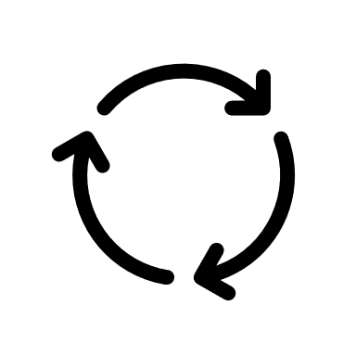
On the construction site Conducting the project
Stick to the schedule
No detours or shortcuts!
Be flexible and open for reevaluation
Review regularly

Slide 6




Inspecting the structure Final evaluation tips
Gather as much feedback as possible
Evaluate the outcomes and the process
Make it visible
Celebrate!

Slide 7
When the scaffold collapses What can go wrong?
The schedule goes... ”too flexible”
The scope becomes blurry
Revisit the schedule
Reprioritize work
Ideally, have a designated person to work with
Revisit the scope
Gather more feedback/seek for advice

Slide 8
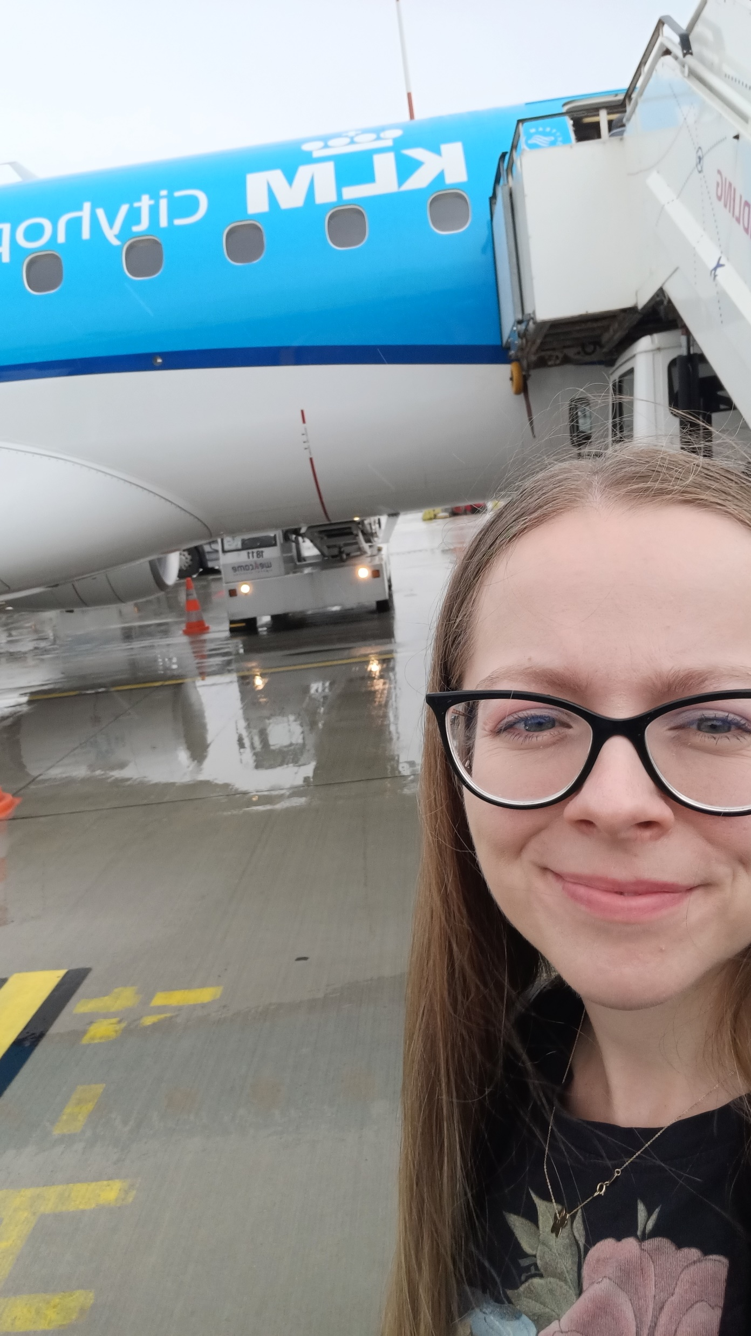
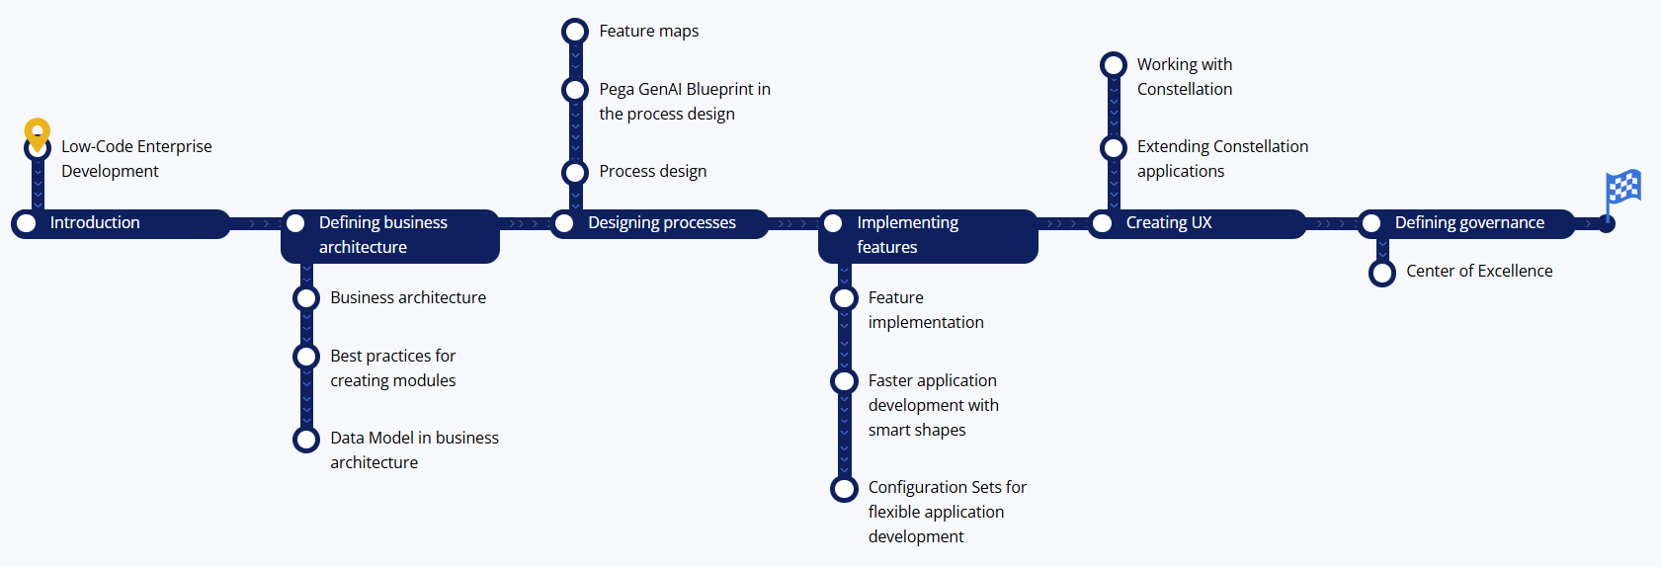
From the job site My success story

Slide 9
Questions ?

Slide 10


Thank You!

