Slide 1
Webinar On
Technical Writing in 2024 and Beyond
Speaker
Gaurav Trivedi
Principal Technical Writer
Red Hat

Slide 2
What I’ll know by the end of this session?
AI Advancements and Job Trends
The Changing Job Landscape
Where are you and what can you do?

Slide 3
AI Index Report | What does it say?
Funding
Funding has reached unprecedented levels covering private and public sectors
AI capabilities
Major improvements in natural language processing
Adoption across sectors
Widespread adoption of AI technologies in almost every sector
Job market dynamics
Creating new roles while also displacing certain traditional jobs.
Notes:
https://hai.stanford.edu/research/ai-index-report

Slide 4
The Changing Job Landscape
Funding
AI capabilities
Adoption across sectors
Job market dynamics

Slide 5
The Changing Job Landscape
Let’s review a few job postings:
https://www.linkedin.com/jobs/view/4021133185/
https://www.linkedin.com/jobs/view/3985470118/
https://www.linkedin.com/jobs/view/4021322126/
https://www.linkedin.com/jobs/view/4032300900/

Slide 6
From Documentation to Experience
Static docs (Pre-2020)
Doc-as-code (2020-2022)
AI, UX-Driven, Continuous feedback
(2023 and beyond)

Slide 7
The path forward? The Skills Employers Want?
Embrace AI
Learn a programming language and become an expert (C++, Java, Python)
Become a real individual contributor (Jack of all trades):
UX writing and UXD
End-to-end product and documentation testing
Content Strategy
Content deliverables in different formats

Slide 8
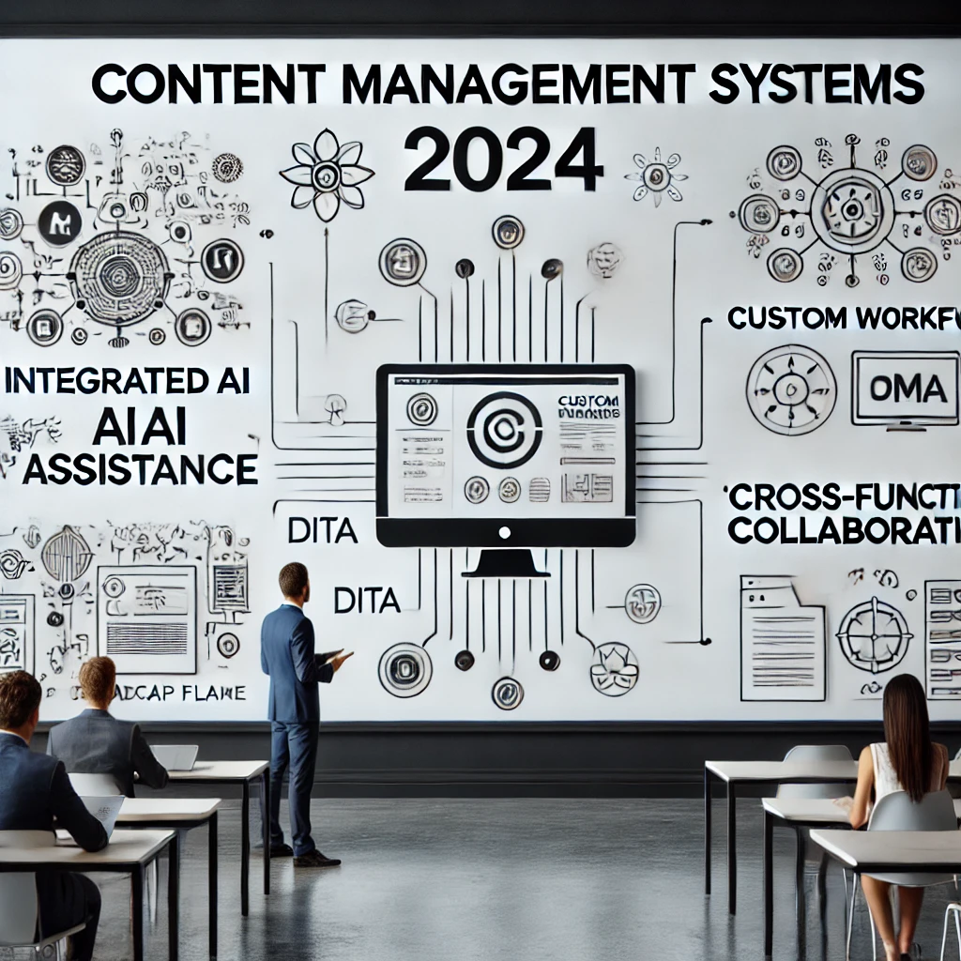
The CMS of the Future
Integrated AI assistance
Custom workflows
Cross-functional collaboration

Slide 9
Collaboration is Key
UX-driven documentation
Feedback loops
DevOps integration

Slide 10
Content Users Will Love
Responsive to user needs
Instant feedback loops
Personalized help docs

Slide 11
Demo

Slide 12
Questions ?

Slide 13
Thank You!

