Slide 1
Webinar On
Documentation in an AI World
Speaker
Mor Saban
Lead Knowledge Manager
Hunters
Notes:
Hello everyone, and welcome to a webinar about documentation in an AI world. The goal of this webinar is to give you a bit of background about AI in general, to go through how we can use it on a day to day basis, but mostly to give you something to think about regarding the future of AI in documentation.

Slide 2
About me
Mother of 3
Technical writer since 2011
Specializing in consolidating external and internal docs
@moralkobiseban
Notes:
I’m Mor Saban. I’m a mother of 3, I’ve been a technical writer since 2011, but my main specialization is consolidating external documentation with internal employee knowledge. At 2019 I started working in Waze as an internal technical writer, meaning I wrote documentation for support agents that provide help to Waze users. It was there that I was exposed to the inefficient documentation methods and the huge overlap between internal and external documentation. I started developing better methods to do this, but only in my next position, as Knowledge Manager in Elementor, could I actually bring my methods to practice and see if it holds water. In this position I also started to dabble with AI to complete small daily tasks for me. With time i realized that this AI thing can completely change the way we grasp our roles as tech writers and what we can contribute in our capacity.
Today I am the lead Knowledge Manager at Hunters, a cyber company and later i will mention how I used AI to make sure no one in Hunters knows I’m actually an imposter and i know nothing about Cyber. So stay tuned.

Slide 3
Overview
What is AI?
What is already being done
What does the future hold?
Questions
Notes:
In this webinar we will cover what AI is, how it’s being used already today in documentation and technical writing, and what the future holds for us documentarians in regards to documentation. And finally, if you have questions, you can ask them at the end. Let’s begin.

Slide 4
What is AI?
What is AI?
How does it work?
Existing language models
“Content is king”
The race to AI
Notes:
First topic, what is AI. We know in general terms, but let’s dive a little deeper into the story behind it.

Slide 5
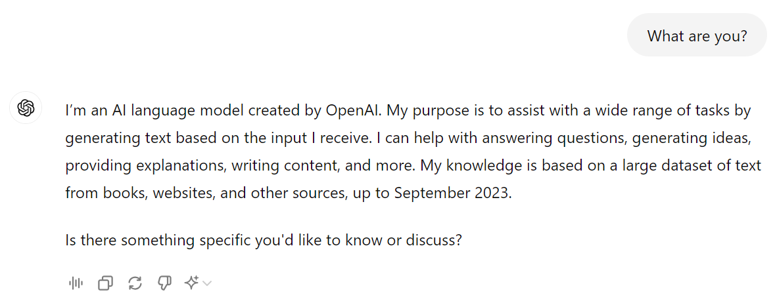
What is AI?
Notes:
So way back when, the internet was created. One web page and another and another until we’ve recently reached hundreds of zettabytes (ZB). Something like more than 170 ZB. A zettabyte is equal to one trillion gigabytes (GB). But a lot of text on the internet is not providing us with new information in and of itself. For instance, if I ask you: what is the color of cabs in NYC? You already know the answer. How? Because you’ve encountered it before. That is an easy one, but what if I asked you how many cabs drive in NYC at any given moment? You could make an educated guess, but you couldn’t definitively tell. But somewhere online, the answer to this question exists. It would take us a while to find the relevant sources, like the NYC transportation authority report or something like that, make a few assumptions and deduce the answer. AI on the other hand can do it in a split second. So AI is like a very smart person who has read every web page in the world and can recall the information super fast.

Slide 6
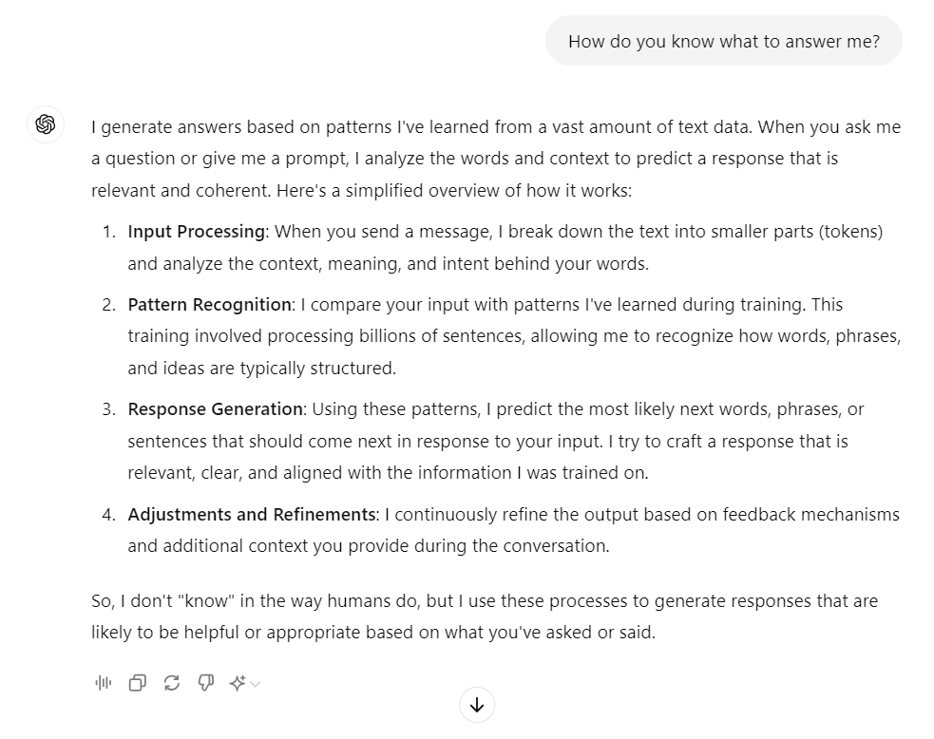
How does it work?
Notes:
But how does AI knows how to understand our questions and answer us in a conversational manner? That’s the language model part. It breaks down our question into small parts, highlighting the most important parts of the question. It analyzes the way humans speak, they way sentences are structured, and then mimics us. The answers are derived from the massive amount of information fed to the language model. So by training the model we achieve 2 things at once: (1) the ability to mimic our conversational style and (2) to provide answers fast.

Slide 7
Existing language models
Notes:
There are several companies building and maintaining language models. These are the major players in this business. We have of course OpenAI, Meta, and Google, but also Mistral which is a French up and coming company, very interesting to follow them. And also Anthropic, which is an American company, but surprisingly their language model is called Claude, which I’d expect to be the name of the AI in the french company, but… there you go. There are also other smaller companies developing language models, like AI21 labs, and others.
So why are so many companies in such a hurry to create language models? To answer that, let’s go into our time machine and go back to the 90s. Fun times.

Slide 8
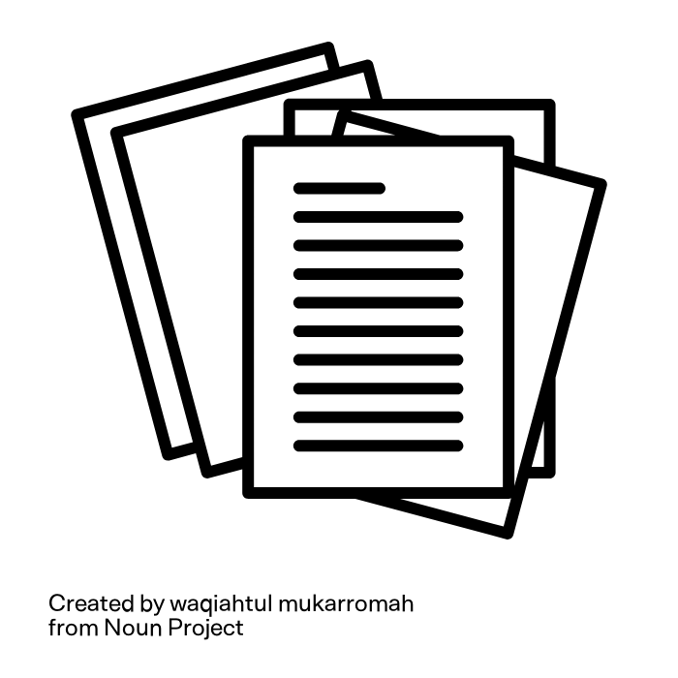
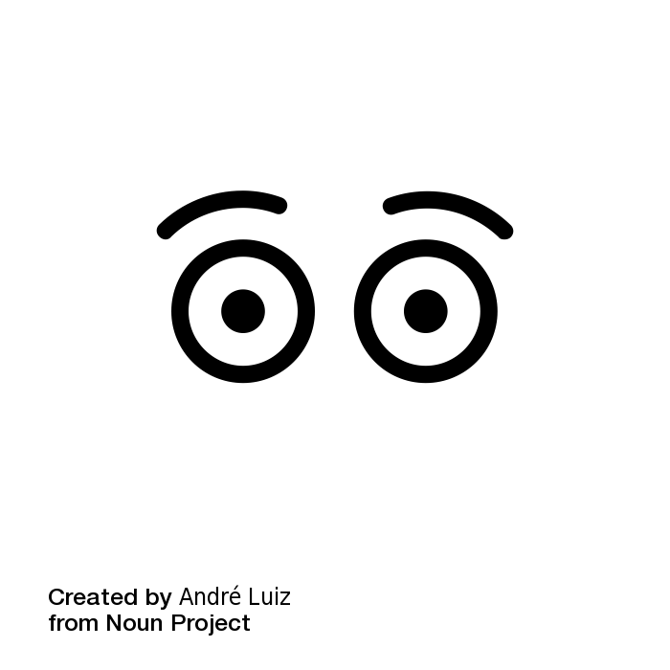
“Content is king”
1996
2024
Notes:
In 1996, the internet crossed 45 million connected users, and Bill Gates wrote a seminal essay titled “Content is King”. He wrote how, in the future, anyone with a PC and modem would be able to create content and share it online, and whoever will learn to do it skillfully will control the narrative and will have huge impact on people. Bill Gates was right. He was so right that we are now in an era of over-content. Too much content is out there competing over our eyeballs, and hardly any content breaks the barrier and reaches a crowd. On the other side of this equation, as information consumer, it’s getting harder and harder to find what we are looking for. So we are now experiencing a paradox, there is so much information out there, but we as people can hardly use it because we can’t handle the volume.

Slide 9
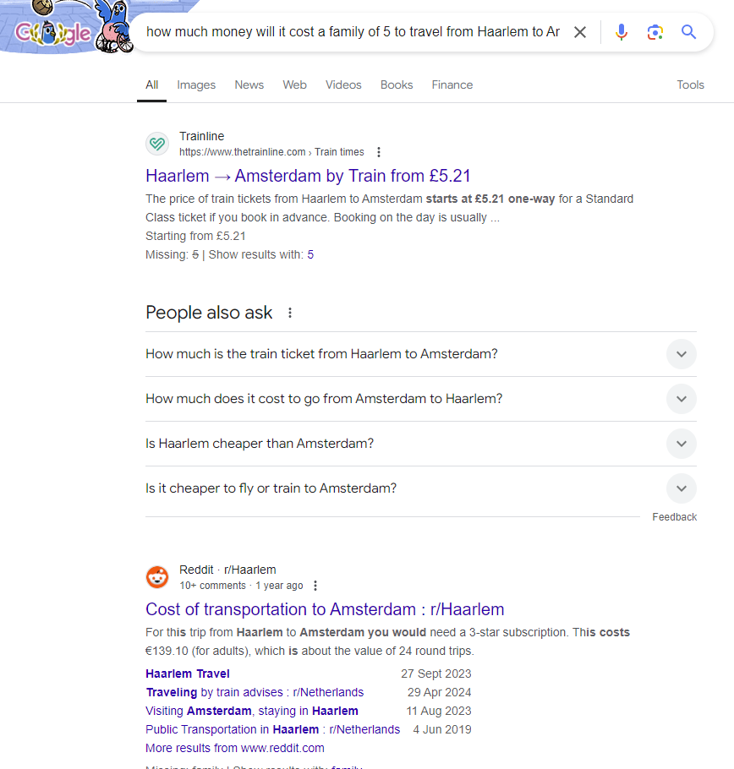
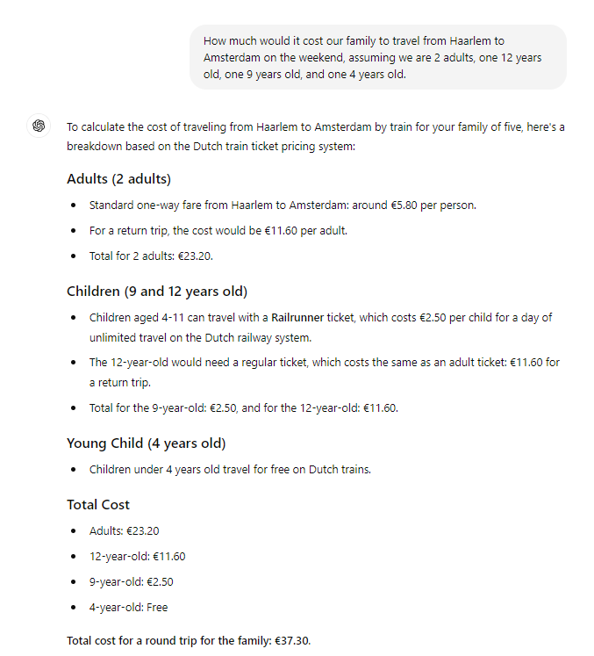
Example
Notes:
Let me give you a real life example. When we Google something, we get answers pretty quick most of the time, but when a question is more complex, we need to sift through several websites, gain knowledge and then make a decision and that takes a long time if it even succeeds at all. For example, I recently moved to a city in the Netherlands, close to Amsterdam. And I wanted to know how much it would cost for the entire family to travel to Amsterdam using public transportation. The Dutch pricing system is so complex, that I literally couldn’t find the answer on Google. There are so many variables involved, the ages of the kids, whether we pay with a physical card or with Google Pay, the hours of the day we travel in, all of these affect the price and all of these variables are explained in different websites! Eventually I just asked ChatGpt and he gave me a very clear answer.
From this tiny example you can understand that I’d much rather use AI to answer these questions for me rather than looking up every information item myself, considering all of the moving parts, and then deducing the answer. So slowly but surely, AI is becoming my main portal for information.

Slide 10
The race to AI
Control knowledge and information
Endless implementation options
Endless data gathering
Fear of staying behind
Notes:
This can explain the crazy race we are witnessing today towards developing AI models. Because, whoever has the best model, the most popular model, will gradually become the largest information and knowledge supplier in the world. Something that provides immense power and brings with it huge financial gain.
Another reason for this race is the neutrality of the technology. Because it can be implemented in almost every field, like healthcare, finance, transportation, manufacturing, academics, it can essentially be a cash cow.
The more people use AI, the more data can be gathered about the way we behave, think, explore, what we’re curious about, what we want to achieve. It’s not new, data about us is already being collected and sold to the highest bidder, but this is another financial channel companies can earn from.
Lastly, once the race begins, big players can’t stay on the sidelines. Once OpenAI launched chatgpt, the race has begun and tech giants like Meta, Google and Microsoft had to take part in it, one way or the other. Microsoft chose to purchase OpenAI, while Google and Meta released their own language models to compete.

Slide 11
What is being done today?
Beginners tasks
Advanced tasks
Notes:
So now that we have basic knowledge about the AI landscape, let’s get into the usage of AI, how it can help us as tech writers in the “obvious ways” but also maybe in new ways we haven’t tried yet.

Slide 12
Beginners tasks
Editing, proofreading and summarizing
Research
Changing tone and voice
Translating
Notes:
So there are a few very common tasks AI can do for us on daily basis. Most of them I’m sure you already do or at least tried once before.
The first is of course being our editor and proofreader. If you work alone, like I do, you don’t have anyone to run your text by, so AI can really help with a sanity check of the text before it’s published.
I also use it to create short background paragraphs on common subjects. Like known cyber threats or popular defense tools. I incorporate these paragraphs almost as is into the docs and it saves me so much time on researching and writing it myself and editing.
I also use AI for research. If I’m in a meeting with a developer and they mention terms I’ve never heard of, I later ask ChatGPT to explain these terms to me and we have a discussion, back and forth, until I feel confident enough to write about this subject. This is also how I beat the imposter syndrome. If you don’t know, the imposter syndrome is when you have a constant internal feeling that you don’t really have the skills people think you have and that someday soon you will be found out. So when I started working for Hunters, it was my first encounter with the cyber field and I knew absolutely nothing about it. What I did was, I asked chatgpt to explain things to me like he’d explain to a 5 year old! I recommend, cheat your way into jobs.
I don’t know about you but I personally am a really bad marketing writer, I also hate doing it. But whenever I get a writing task that should be have somewhat of a marketing tone, I write a draft and then ask ChatGPT to help me make it more marketerial. It takes a few version until he reaches a draft that I like. I also give him examples from other resources about the kind of tone and voice I’m looking for.
And also, of course, translating and reviewing auto translation tools.

Slide 13
Advanced tasks
Managing UX library
Creating visuals and flowcharts
Performing tasks in bulk
Analyzing usage data
Notes:
So there are a few tasks that we could do but I suspect most of us haven’t tried yet, either because we’re not sure how to do it or because the documentation tools we’re using are still not supporting it.
If you are a writer or knowledge manager who also writes the UX text, then you know that maintaining a consistent UX library is hard. There are tools that do it for you, like Frontitude, which is a great Figma add on but it’s expensive and takes a while to implement so an easier option is to feed the information to AI and query it whenever you need. For instance, I can go to chatgpt and send him a list of my UX terms and an explanation of the situation when we use each term. And later I can go back and ask: Can you tell me which term do we use on the cancellation button? Or which title text do we have on the warning pop-up? Super useful.
I know of some people who already create visuals and flowcharts using AI. I must say I haven’t actually taken a flowchart from AI and implemented it as is in my docs, but I can say that I use it to provide me with suggestions on how to visually represent complex information. I usually drop a textual explanation and ask him to provide a suggestion for a flowchart and from there I take the concept and adapt it manually.
So performing tasks in bulk is something I really wish I could do. Not all writers will feel the need for this tool but when you work with repetitive articles like myself then you might. So for example, sometimes I want to add the same warning panel to more than 40 articles. Today I have to write the warning as a snippet and embed the snippet in each article. But wouldn’t i t be amazing if I could tell an AI assistant: Take this snippet and embed it at the top of all of the articles under category XYZ? I would also love an option to prompt AI to do something like: Publish all of the articles that were moved into draft status in the last 24. In some tools you can do this using API, but it’s really not available daily as a one off task.
Another thing I’d love to do is to be able to query usage data using plain language. Today most tools give us analytics in charts and tables. But if I want to get an answer to a fairly complex question I need to download the data and then analyze it manually. I wish we could dump the data into an AI and ask: how many people closed a “quick start guide” article in less than a minute. That would give me great insight into which articles need improvement, what’s working or not working, where do I need to focus my attention.

Slide 14
What does the future hold?
Focus shift
Job responsibilities change
Overlapping disciplines
Notes:
So I’ve spent a lot of time speaking with AI experts about the way documentation will change our landscape as technical writers in the future, and these talks provided my with some insights into the way our thinking will change, and the way our focus will change as we do our job.

Slide 15
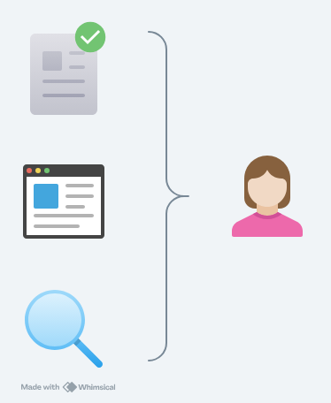
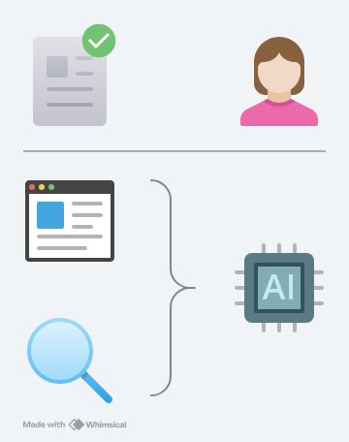
Focus shift
Today
In the future
Notes:
Today I feel like we juggle 2 aspects of documentation: one is the aggregation and maintenance of the information, and the other is the way this information is retrieved by the user. Meaning, as a writer today I have to make sure I have the most accurate information, but I also make sure there is a portal through which the user can find this information. I invest in a help portal, with good searchability, I design it in a visually appealing way, with numbering, and screenshots, and the proper space in between, and everything has to be neat and tidy. What I think will happen in the future is we will shift our focus to only the first part of this equation, and we’ll let AI do the retrieval part for us. Meaning, we will focus on maintaining a very accurate source of information, but that will be the extent of it. From there on, users will prompt AI whichever way they feel comfortable with. They can ask AI to provide a textual explanation to what they need, they can ask AI to send them a relevant video of this, but I predict we will no longer build navigation trees and invest in the structuring of the information.
I’m not sure if you remember this but 7-10 years ago, there was a trend in documentation where companies started incorporating more gifs, more videos into their docs. Rich media, they called. That was the buzz word. And then Google published some studies about the success rate of incorporating rich media in their docs. And the critical result from these studies was that different people have different learning preferences. And that is the core concept behind what I’m talking about. Because different people have different learning styles, we should be providing them with a variety of ways to learn. But that is so expensive and time consuming that today i think the only companies doing it right are the big ones, like google, microsoft, maybe service now, but it takes a robust team of content creators to do that. In the future, we will be able to achieve that using AI. We will be providing it with our source of truth, and the user will be prompting for information the way that is most comfortable for them. Text, numbered procedures, images, videos, whatever. We will not be creating all of this content, we will just be feeding the accurate information to the AI engine and that’s it.

Slide 16
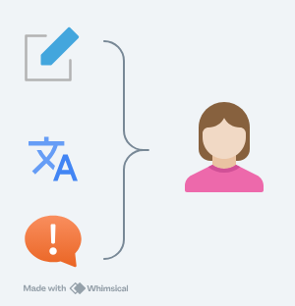
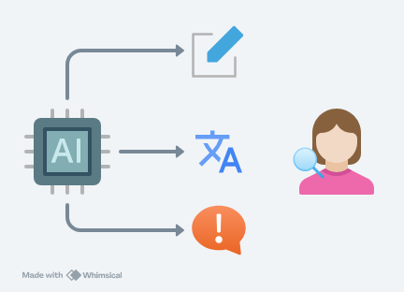
Job responsibilities
Today
In the future
Notes:
This leads me to the second change I believe we will experience as AI becomes more developed and integrated into our field: the change in what we do on a day to day basis. Our daily tasks. Because more of our writing tasks will be done by AI, we will become more of Knowledge Managers than Technical Writers. We will write less, and organize more.
We will do less “manual labor” and more strategic thinking and planning, more knowledge architecture. So the writing, and editing and translating parts of the job will be performed by AI. I predict we will find more job titles like: Knowledge architect, Knowledge strategist, Documentation owner, and less “Technical writer” because, again, the writing part will be the responsibility of AI and we will manage it, review it, make sure everything is accurate and to our standards.
BTW this is already visible today in Marketing teams. We see less Marketing Writer positions, and more Marketing Managers, which are able to look at marketing from a higher perspective than just performing the writing task itself.

Slide 17
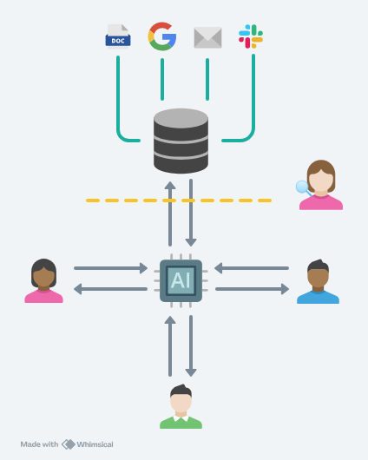
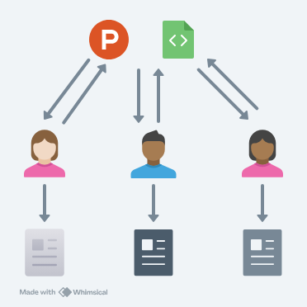
Overlapping disciplines
Notes:
Today some of us work in a completely structured documentation methodology using tools like Document360 etc, and some of us work with an unstructured methodology like topic-based documentation. As AI becomes more prevalent in our professional lives, we will gradually transition into a completely unstructured documentation system.
Why am I saying that? Because as we slowly shift our focus towards the information maintenance part of the job and less about retrieval, there is no reason why the information we maintain will stay in a closed repository, while the company maintains many other information repos. It doesn’t make sense.
For instance, in every organization today we can find information on Jira, on Slack, Confluence, emails, our own documentation, Google docs and slides people create. Why are we not incorporating this information into our docs? I believe that in the future all of these resources will be routed into one pool of information where our job will be to mark which information is up to date and accurate, and which isn’t. We will also be in charge of determining which information should be shared with our users and which is internal company information. This way we will be sharing one information resource with employees and users. The marketing team will not base their marketing writing on different resources than we do. There will be one single source of truth, and everyone in the organization will be able to prompt AI to provide the information they need.
An example of this will be a marketing writer prompting AI to give them a marketing text about the company’s latest product line, and a support agent prompting AI to give them a canned response to a user who is experiencing this issue, and the developer is prompting AI to tell them how a specific feature works, and all of them are tapping the same information resource, which is managed by the technical writer or knowledge manager.

Slide 18
Questions ?

Slide 19
Thank You!

