Slide 1
Webinar On
Seven Best Practices for
API Documentation Writing
Speaker
Robert Delwood
A Lead API Documentation Writer

Slide 2
About Me
Programmer.
Writer.
Programmer-writer.
Developer
Technical writer,
API documentation writer
Microsoft Office automation, tools writer
Companies: Microsoft, NASA, Walmart

Slide 3
Disclaimers
This isn’t the only way
Your milage may vary

Slide 4
Of API Documentation
“
Writing documentation. That's easy.
Writing great documentation. That’s hard.
Robert Delwood
LinkedIn (https://www.linkedin.com/in/robert-delwood-890a2a)
”

Slide 5
Overview
API documentation is a rich and complex project
It must everything to everyone, though not equally
Mostly developers, but from junior to senior level
Project and product managers
C suite readers
Learn the theory, the rest is easy
Seven best practices to guide API documentation writing

Slide 6
Learn the theory, the rest are details
Learning rules does not work
Too hard to memorize
Too rigid
Learn the overarching goals
The audience
The purpose of the API
The direction
The important points first

Slide 7
Readers don’t read, they skim
No one reads API documentation
They skim
They’re looking for one specific piece of data
Don’t even make them use the reference
Code as Docs
Skimming means
Short sentences
Spaces between paragraphs
Most import information first
Above the fold
Keep them on the page at all costs

Slide 8
You write for yourself
If you don’t understand, stop and get to understand it.
Write as if you’re explaining it to yourself
They will only know what you know

Slide 9
You can push back
See yourself as equal to developers
Our speciality is presenting it to clients
Our speciality is the developer experience
Writers can push back to developers
Examples
Field names: Cryptic and not spelled out
Too complex or overloaded functions.
Strings for numbers
String case consistency
Id
page_no | Page_number
phone | client_phone delivery_phone
id | client_Id process_Id
desc | description
maxLength | maximum_Length
uom | unitOfMeasure
dap | ???
“5” | 5
ONTIME, lagtime | ONTIME, LAGTIME

Slide 10
Read other’s APIs
APIs include text books, videos, and print
See how you learn best
See what you like and dislike, then improve on both
Adapt their formats to your own style and idiom.

Slide 11
Postman
Make each request in Postman
You’ll
Understand the request better
Find developer/documentation inconsistencies
Find errors
Create a collection for the SDK

Slide 12
Examples, examples, examples
Developers want examples to:
Copy and paste
Visually see examples
See formatting. Formatting along may answer their question
Every field must have an example
Every request must have at least one example.

Slide 13
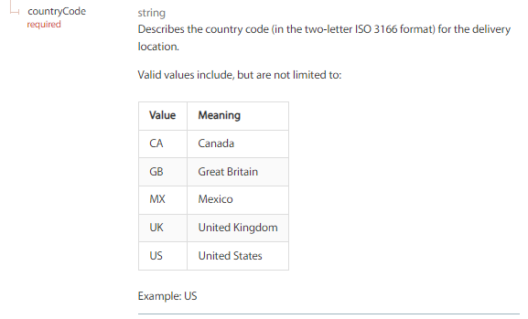
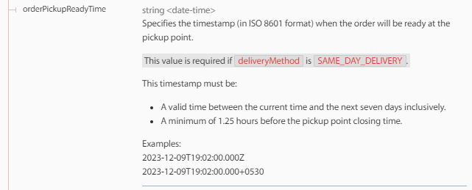
Example 1
Example 2
Example 3
Example 4

Slide 14
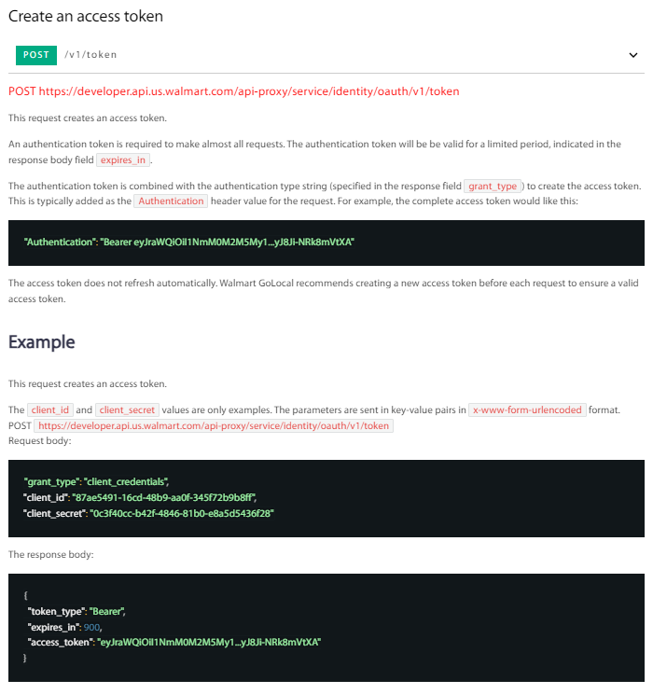

Slide 15
Bonus: Words mean things
Don’t use Swagger. Does not exist. It’s OpenAPI. Don’t use it.
API writers. That’s a developer. We’re API documentation writers.
API. An API is a collection of requests. A request is an individual endpoint.
Should. Avoid. It implies an alternative and often in APIs there is not.
Unique. Do not use. It never adds any values.
Use one term and consistently
We’re not a literary society
API
API call
API request
Call
request.
Search
Find
Fetch
Return
Get

Slide 16
Questions ?

Slide 17
Thank You!

