Slide 1




Webinar On
Centering Your Customer in Content
Speaker
Mysti Berry
Technical Writer
CrowdStrike

Slide 2

You may be wondering
What does Mysti know about this topic?
30+ years as a technical writer for companies as diverse as Salesforce and 20th Century Fox
Award-winning (unproduced) screenwriter
Award-winning writer and publisher of short crime fiction
Linguistics degree from UC Santa Cruz, a top-five program
I put together insights from all these areas to improve my tech doc.

Slide 3
Centering Your User?
We’re all enthused customer advocates…isn’t that enough?
Using specific grammatical and structural techniques can keep your customer feeling like they are the center of any process they read about. This can reduce cognitive dissonance and reinforce your company’s “customer-first” orientation.

Slide 4
Overview
Center your customer throughout your content:
”Centering” briefly explained
Word choice and sentence structure
Workflow diagrams
Structure

Slide 5
Where is your customer?
Oracle is the world’s most popular database.
With ODP.NET, Managed and Unmanaged Drivers can be deployed easily to common hosted and third-party cloud environments through Web deploy.
This article provides links to download the Microsoft Build of OpenJDK.
Notes:
In English, the grammatical subject of the sentence is the center. Where is the user in these sentences? Can we easily and concisely add them?

Slide 6
How would you center the user?
Oracle is the world’s most popular database. Use Oracle, the world’s most popular database…
With ODP.NET, you can easily deploy Managed and Unmanaged Drivers can be deployed easily to common hosted and third-party cloud environments through Web deploy.
This article provides links to Download the Microsoft Build of OpenJDK.
Notes:
In English, the grammatical subject of the sentence is the center.
Imperative has an implied subject “you.”

Slide 7
How do you know this is better?
Think about how you felt as you read the headings to the previous slides.
I deliberately put YOU in almost every heading.
Did you feel engaged? Valued? Centered?
Notes:
In English, the grammatical subject of the sentence is the center.
Imperative has an implied subject “you.”

Slide 8
Our job is not to document software
Our job is to use words and images to help the customer on their journey through our product to get back to their day job.
Notes:
In English, the grammatical subject of the sentence is the center.
Imperative has an implied subject “you.”

Slide 9
Summary: “centered” guidelines
Use “you” (the customer) instead of “us” (the company/product) as the subject, or the imperative (the erased “you”)
  You can’t do this 100% of the time—but the more you do it, the more centered the customer will feel.
  Reference content offers fewer chances to do this.
  Concision and friendliness are sometimes at odds.
Avoid self-reflexive text
We’ll talk more about headings in the last section
Notes:
You can’t do the first bullet 100% of the time!

Slide 10
Centering with workflow diagrams
We often start a workflow with the first thing that happens. That choice doesn’t always center the user.
Left vs. right matters (for English readers).
Describe the workflow in terms of the customer’s job to be done.

Slide 11
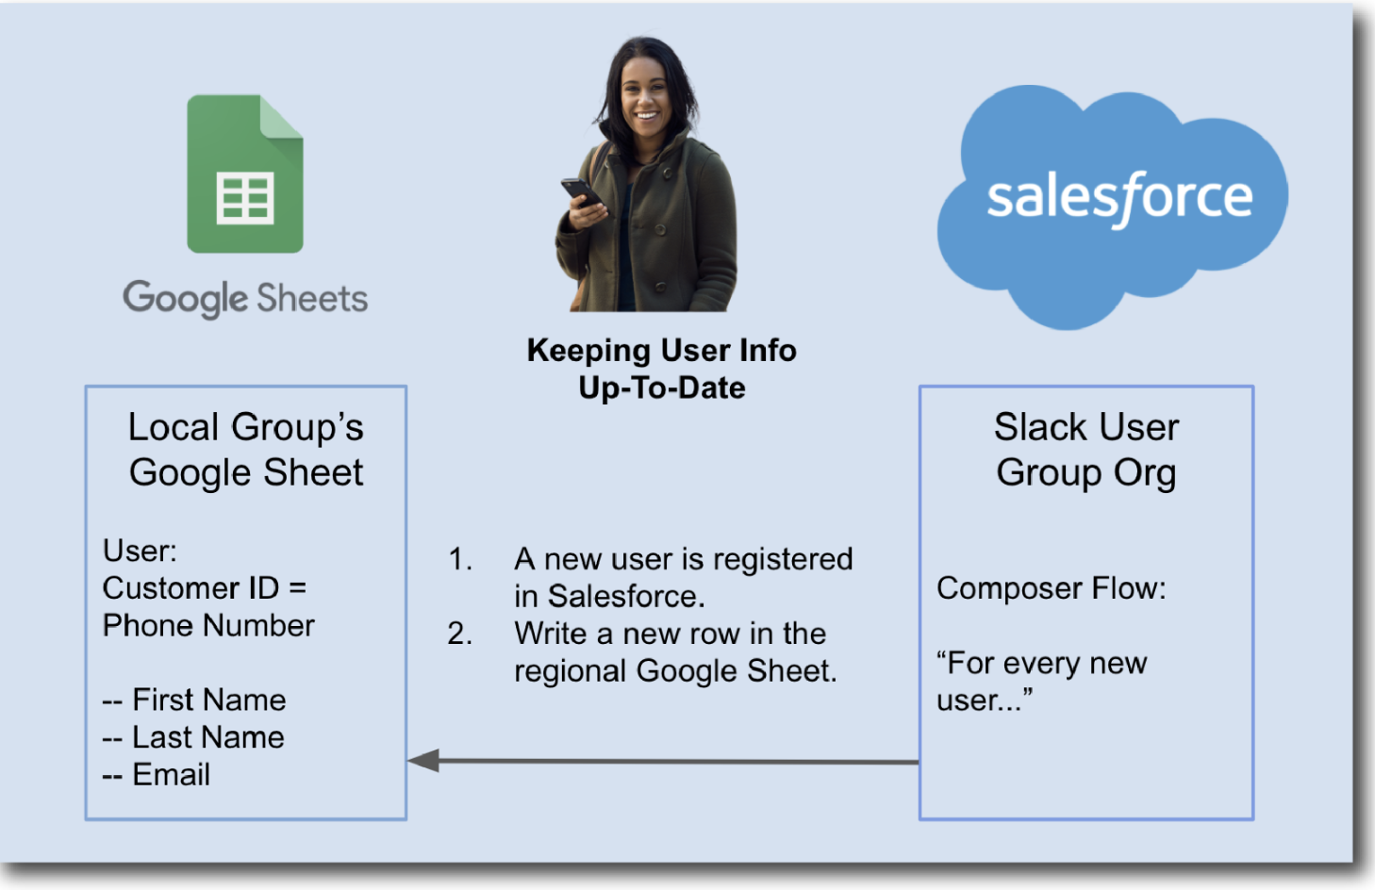
Bad example: workflow

Slide 12
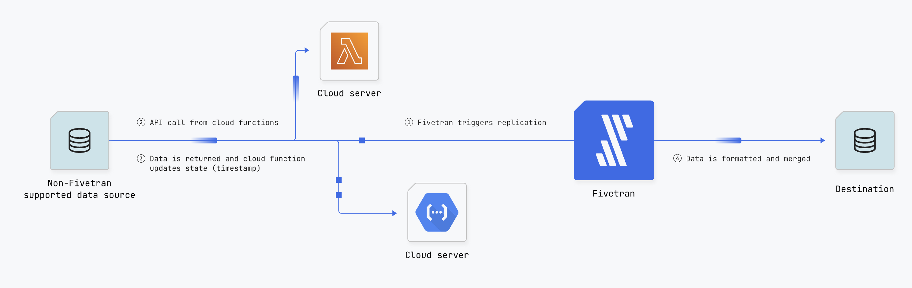
Good example: workflow
Notes:
Starts on the left (for English-speaking audience) with the customer (their data). The company providing the service is easy to spot, but isn’t the starting point.
The diagram explains what happens to the customer’s resource at every step.

Slide 13
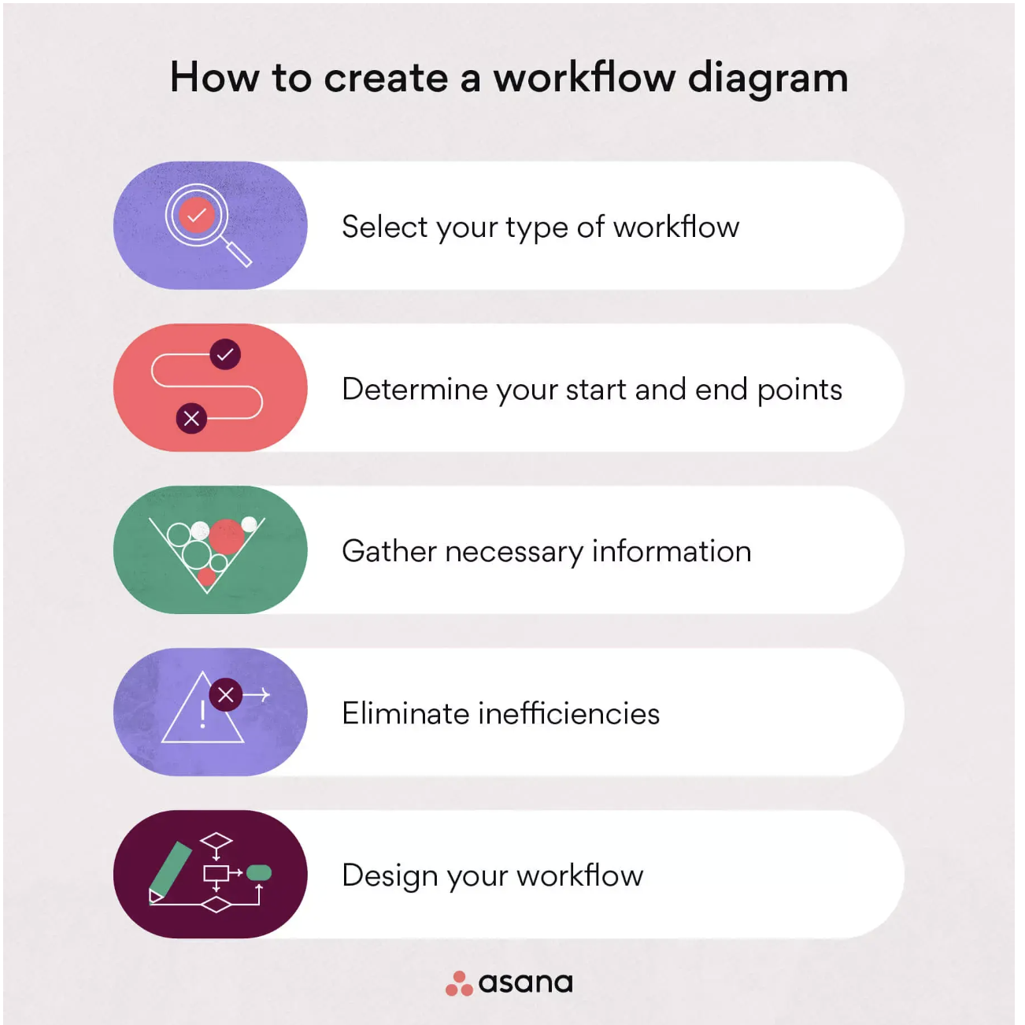
Better example: workflow
Notes:
Every step in the workflow is a task that centers the customer!

Slide 14
Summary: workflow guidelines
Start the workflow from the customer’s “desk” (their cloud or instance or data store…).
For English speakers, work left to right.
Describe the workflow in terms of the customer’s job to be done.

Slide 15
Centering with structure
Personas are a good start. Many companies get by with dev/admin/end user, some companies get more granular.
Consider the jobs to be done when structuring content.

Slide 16
Does structure even matter?
Your customers are likely first accessing your content from a search engine (or an AI bot?).
However, if they can’t find exactly what they are looking for on the first result they click, they are likely to do some hunting and pecking (information foraging).
If your search isn’t great, the hunting and pecking is much more likely.

Slide 17
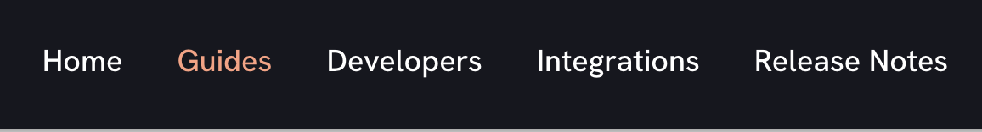
Less helpful example: structure
Mixed taxonomy: content deliverable vs. persona vs. task vs. content type
Where’s the customer?

Slide 18
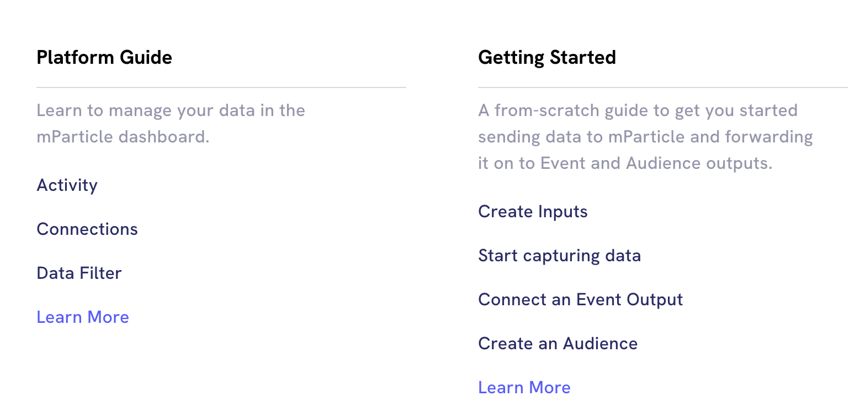
Halfway there…
Titles on the left are product and feature names
Titles on the right are close to customer goals…

Slide 19
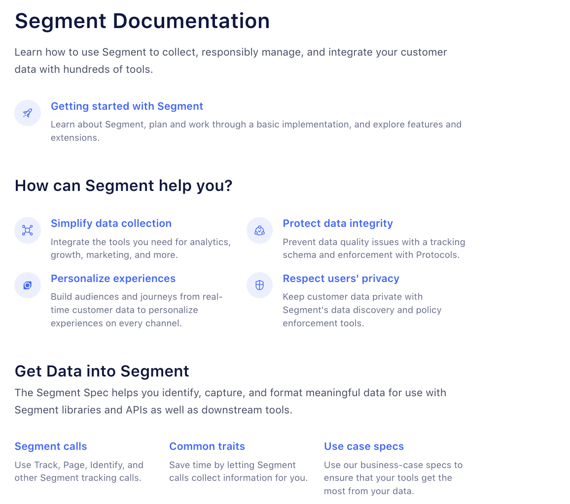
Mostly there!
Customer’s job to be done in the headings.
Customer is literally referenced or implicitly referenced
Notes:
If you go to the site, http://segment.com/docs, you’ll see the product-name list on the left. Teams often create landing pages to correct deficiencies in their overall content structure in lieu of fixing the structure.

Slide 20
Structure summary
Structure content around the customer’s jobs to be done. Lead them through the product, don’t itemize the product’s architecture.
Keep the top-level nodes within a single taxonomy: content type (most common, perhaps least useful), user goal, persona.
The organization will often resist structure changes—some feel a perceived loss of importance if their group’s product name isn’t in the top level. Best way to fight this—invite them to navigate through a customer goal using only the product doc.

Slide 21
Overall summary of things you can do
Create a style guide that recommends customer-centric standards
  Use imperatives
  Get rid of self-referential text
  Puts the customer in the subject where possible
Create workflows that start on the left and with the customer’s data or machines (even if the timeline is different)
Structure your content around “jobs to be done” or the customer’s path through the product, or create landing pages that provide this information.

Slide 22
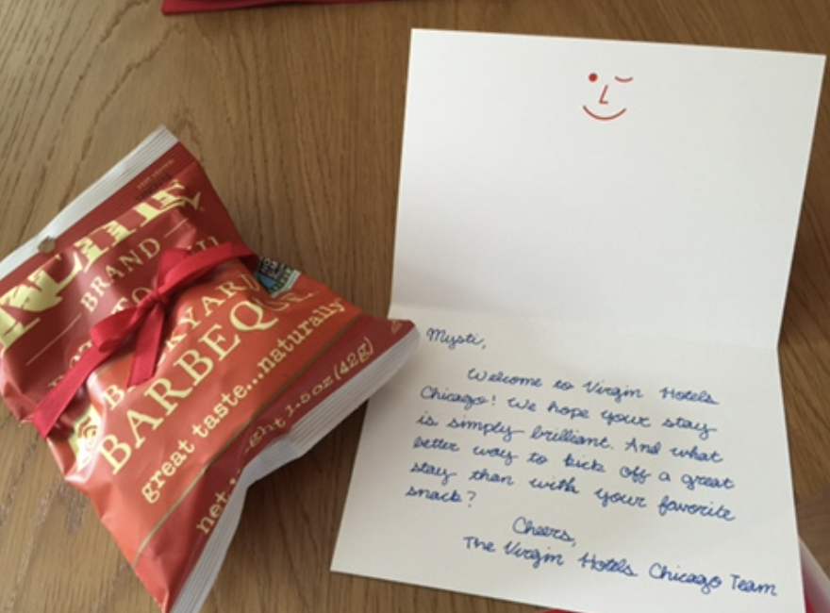
At the end of the day…
We hope our customers spend as little time in the product doc, and as much time being successful, as possible.

Slide 23
Resources
These slides are available at mystiberry.com/secret so you can download and follow the links.
Future tense examples
Information foraging and the scent of information
Example of a great landing page with the same old “shipping our org chart” table of contents.
Content architecture primer
Jobs to be done primer

Slide 24
Questions ?

Slide 25


Thank You!

