Slide 1
Webinar On
CROSS-FUNCTIONAL COMMUNICATION FOR TECHNICAL WRITERS
Speaker
Raghuram Pandurangan
Sr. Manager - Content
PayU India

Slide 2
Agenda
Adapting to Agile
Collaborate with Product Teams
Adapting Generative AI
Working with Support or Integration Teams
Tools for Collaboration

Slide 3
Adapting to Agile
Challenge:
Agile processes prioritize minimal upfront documentation.
Adaptation:
They should be part of agile teams for early access to development.
Understand user pain points and advocate for the audience.
Technical writers gather information through conversations and adapt to ongoing changes.
Sprint+1 if you are with product team sprint or having a separate JIRA board

Slide 4
Adapting to Agile [Contd.]
Planning
Requirements Gathering
Audience Analysis
Designing
Templates Deliverables
Tools, style guides
TOC
Reviewing
Publishing & Compiling
Maintaining versions
Technical
Editorial review
Creating content
Iterative content
Integrating feedback
DDLC

Slide 5
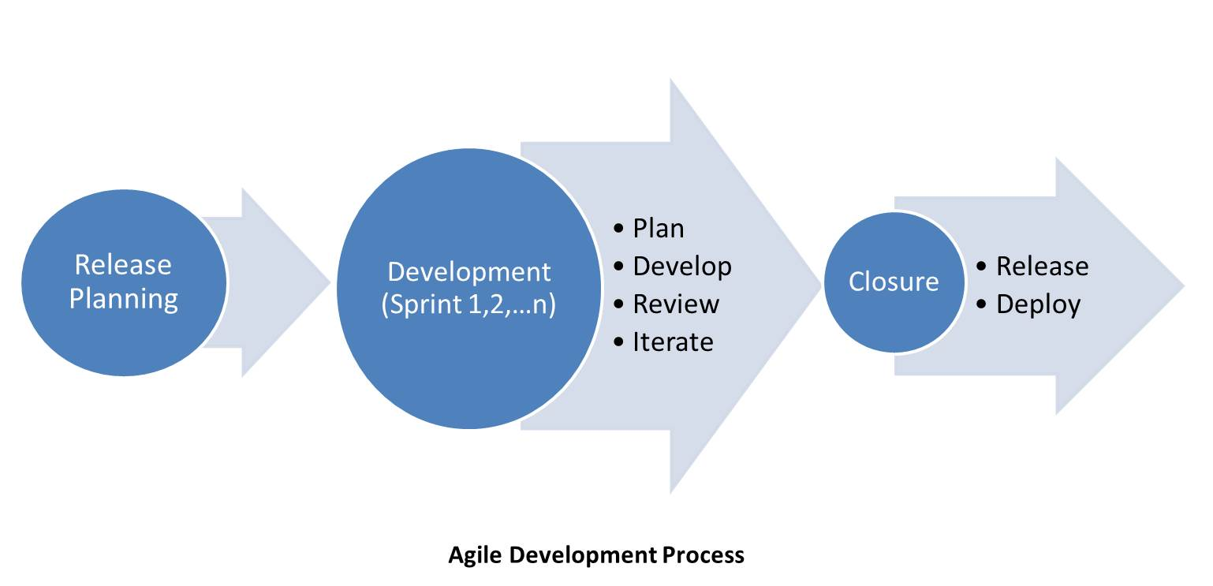
Adapting to Agile [Contd.]

Slide 6
Collaborate with Product Teams
Collaborate with product managers, developers, testers, and other stakeholders.
Include stakeholders in help authoring tools evaluation (esp., startups, setting up new doc site)
Directors/PMs
Support Team
FE Team
UI/UX
Synthesize different perspectives to create relevant and concise content.

Slide 7
Using Generative AI
Explain the management
Potential and limitations
Keeping Confidential and Privacy
Seek approval

Slide 8
Using Generative AI
List the use cases
FAQs
Proof Reading
Code Generation & Walkthrough
SEO (metadata desc. & search keywords)

Slide 9
Working with Support Teams
Technical writers gain insights into common user issues and pain points through direct feedback from support teams.
Support agents leverage comprehensive documentation to provide efficient and accurate assistance to users.
Collaboration with support teams ensures accurate and timely resolution of user queries.

Slide 10
Working with Support Teams [Contd.]
Process & Communication
Establish regular communication channels with support teams.
Set up process to ensure product docs are validated by support teams.

Slide 11
Tools for Collaboration
Review
Acrobat
Office 365
Tasks
JIRA
Content Sharing
Confluence
Sharepoint

Slide 12
Questions ?

Slide 13
Thank You!
https://www.linkedin.com/in/raghuram77/

