Slide 1
Webinar On
User Research for Technical Documentation
Speaker
Corlynne O’Sullivan
User experience and technical writing consultant

Slide 2
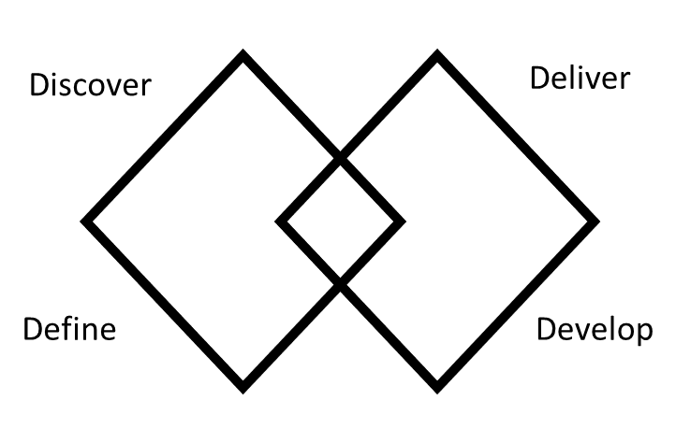
Overview
Applying a UX framework — the double diamond
to help research for documentation

Slide 3
Validating your documents with users
Using the UX double diamond framework
Discover: Identify your users and stakeholders. Who are they,
and what roles do they play in the process?
Define: Specify their requirements and determine the most suitable approach to meet their needs.
Develop: Assess the usefulness of the chosen approach. Have you validated the variations to ensure they align with user and stakeholder expectations?
Deliver: Set a timeline for delivery and confirm readiness. Have you validated the developed solution, ensuring it meets the expectations of both users and stakeholders?
Discover
Deliver
Define
Develop

Slide 4
Discovery phase for technical documentation
Phase one of the double diamond UX framework
Objective: Uncover insights to inform documentation
strategy.
Discover
Deliver
Activities:
Conduct user interviews and surveys to understand needs.
Conducting secondary research to back your findings
Define
Develop
Analyze existing documentation usage and pain points.
Identify key user personas for targeted research.

Slide 5
Define phase for technical documentation
Phase two of the double diamond UX framework
Objective: Refine focus and generate ideas for documentation improvement.
Activities:
Synthesize user research findings to define key challenges.
Collaborate with stakeholders to brainstorm solutions.
Prioritize ideas based on user needs and business goals.

Slide 6
Develop phase for technical documentation
Phase three of the double diamond UX framework
Objective: Transform ideas into tangible documentation solutions.
Activities:
Explore various documentation formats (tutorials,
FAQs, etc.).
Work closely with subject matter experts for accurate content.
Prototype documentation layouts and styles.
Iterate based on feedback from both technical and non-technical stakeholders.

Slide 7
Deliver phase for technical documentation
Phase four of the double diamond UX framework
Objective: Prepare and release refined documentation.
Activities:
Validate prototypes through usability testing.
Finalize documentation based on user and stakeholder feedback.
Establish a communication plan for documentation release.
Implement training sessions for support teams and end-users.
Monitor post-launch feedback and usage for continuous
improvement.

Slide 8
Questions ?

Slide 9
Thank You!

