Slide 1
Prompt engineering for technical writers
Speaker
Selvaraaju Murugesan
Head of Data Science, Document360
https://www.linkedin.com/in/selvaraaju
Notes:
Workshop – 2.5 hours
Since the introduction of ChatGPT-4, technical writers need to shift their thinking in producing any knowledge base content which is AI-friendly and makes it easy for both AI bot and humans. This workshop provides step-by-step methods and tools to produce content and metrics to evaluate producing AI-friendly content

Slide 2
Overview
Prompt engineering basics
Generic prompts for technical writers
Prompts for business use cases
Notes:
Example

Slide 3
Session 1
Notes:
Session 1

Slide 4
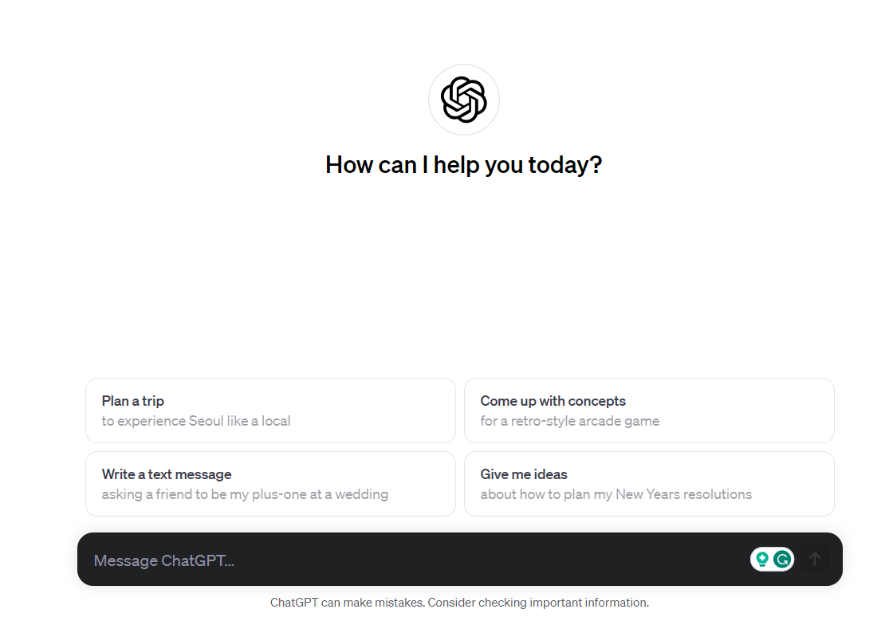
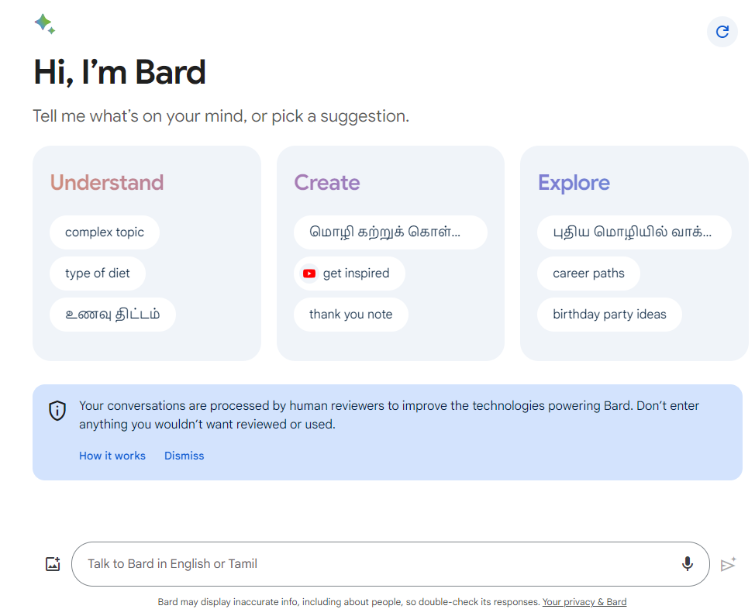
Trends
ChatGPT
Bard

Slide 5
Prompt Engineering
Tactics used to get what we need!
Objectives are important

Slide 6
Prompt Engineering
A prompt can contain information like the instruction or question you are passing to the model and include other details such as context, inputs, or examples

Slide 7
Elements of Prompt
Instruction
Verbs
Context
Describe in detail
Input data
Text / Paragraph
Output format
JSON, Table, etc

Slide 8
Session 2
Notes:
Session 1

Slide 9
Documentation Development Life Cycle
Learning how to frame a question with the
desired intent in mind helps you
get the right information

Slide 10
Prompt Engineering – Tactic 1
Clarity in instructions
Specifics & detail
give me a list of influential technical writers | -> | give me a five technical writers who are from USA
Write an essay about knowledge management | -> | I want to write about knowledge management. Create an article outline on knowledge management with two headings and three sub-headings for each heading
What is a good name for a cat | -> | Suggest some names for a fluffy cat
Notes:
Sky is …
Complete the sentence : Sky is

Slide 11
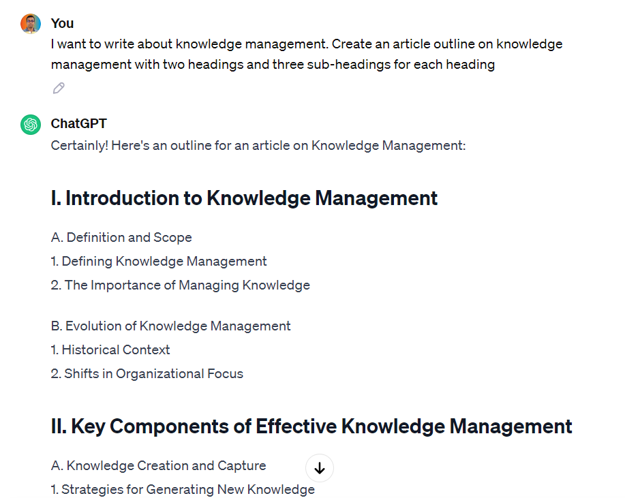

Slide 12
Prompt Engineering – Tactic 2
Show and tell
Suggest three names for an animal that is a superhero. | -> | Suggest three names for an animal that is a superhero based on marvel comics Animal: Cat Names: Captain Sharpclaw, Fantastic Fluffball, The Incredible Feline Animal: Dog Names: spider the Protector, Black Canine, Iron paw Animal: Horse Names:
Few-shot prompting
Notes:
Suggest three names for an animal that is a superhero based on marvel comics Animal: Cat Names: Captain Sharpclaw, Fantastic Fluffball, The Incredible Feline Animal: Dog Names: spider the Protector, Black Canine, Iron paw Animal: Horse Names:

Slide 13
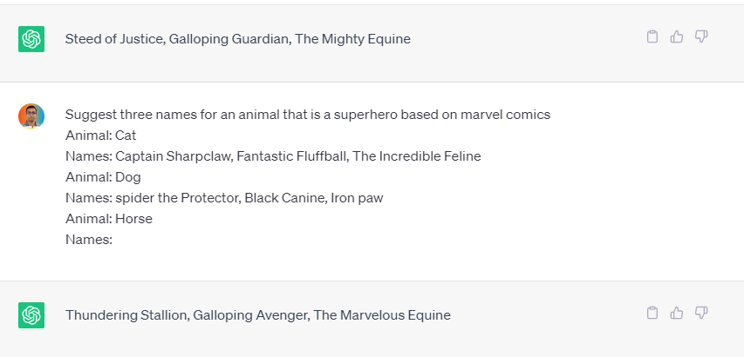

Slide 14
Prompt Engineering – Tactic 3
Use personas to get tailored output
Write an email response to “"I have been waiting for your response for the last 3 months. Your service is bad." | -> | You are a call center assistant. Write a response to this email "I have been waiting for your response for the last 3 months. Your service is bad.“; write it in a professional tone
Write a review of Pizza hut | -> | You are a food critic. Write a review of Pizza hut
Write an email to a customer advising them about a scheduled outage for 24 hours |  | You are a customer success manager. Draft an email to a customer advising them about a scheduled outage for 24 hours of your software platform; Write only 6 sentences

Slide 15
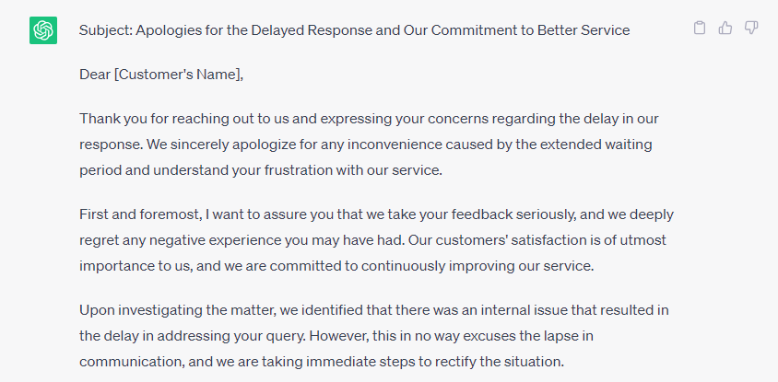

Slide 16
Prompt Engineering – Tactic 4
Specify output formats and its characteristics
Summarize the text | -> | Summarize the text delimited by triple quotes in about 50 words.
 |  | Summarize the text delimited by triple quotes in 2 paragraphs.
 |  | Summarize the text delimited by triple quotes in 3 bullet points.
 |  | Provide response in JSON format with “message” and “subject” as a key value pair

Slide 17
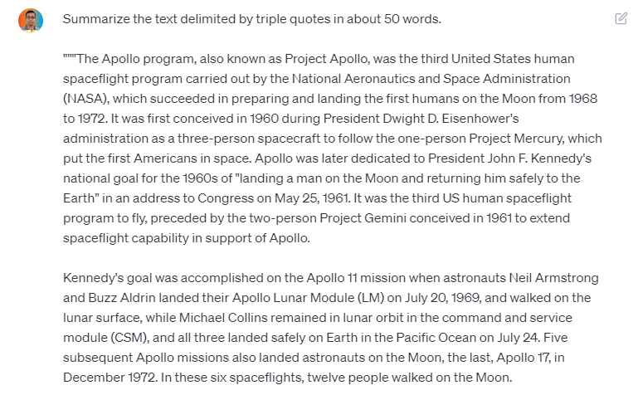

Slide 18
Prompt Engineering – Tactic 5
Specify output formats as table
Summarize the text “In a recent business report presentation, the CEO of Zana Corp. highlighted their remarkable growth in the past fiscal year. She shared that the company experienced a 15% increase in revenue, reaching $50 million, with a 12% profit margin ($6 million in net profit).” | -> | Generate a table containing this information: “In a recent business report presentation, the CEO of Zana Corp. highlighted their remarkable growth in the past fiscal year. She shared that the company experienced a 15% increase in revenue, reaching $50 million, with a 12% profit margin ($6 million in net profit).”

Slide 20
Prompt Engineering – Tactic 6
Iterative fine tuning
What is the distance between Berlin and Paris? | -> | What is the distance between Berlin and Paris?
 |  | Compare it with the distance between Munich and Paris so that I can access
 |  | in one word

Slide 21
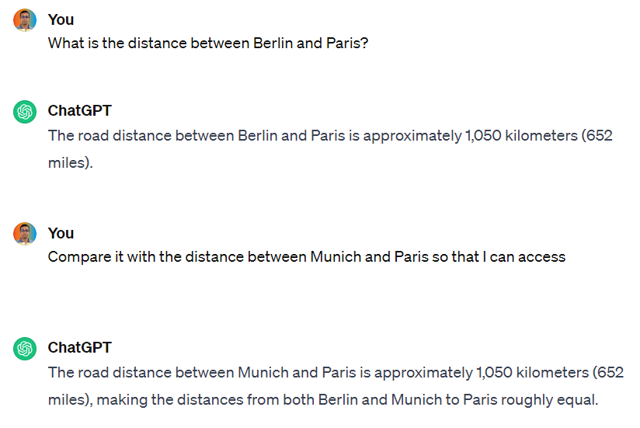

Slide 22
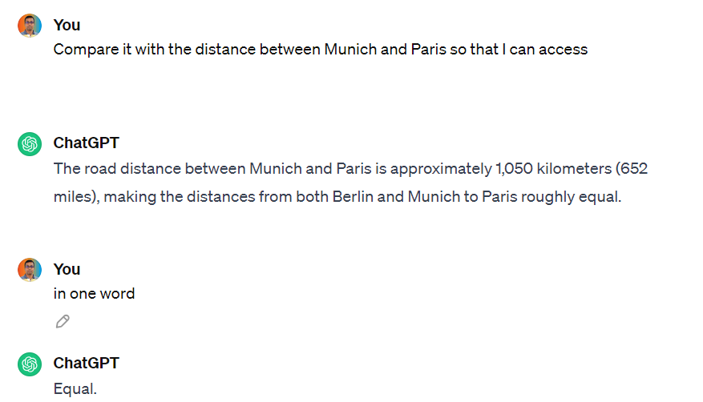

Slide 23
Prompt Engineering – Tactic 7
Code generation & debugging
Act as a junior python programmer. Write a code to generate Fibonacci series |  | Debug this Python code: 1. pizza_cost = 100 2. partygoers = 10 3. while partygoers = 0: 4. cost_per_person = pizza_cost / partygoers 5. print("the cost per person is $", "{:.2f}".format(cost_per_person)) 6. partygoers -= 2

Slide 24
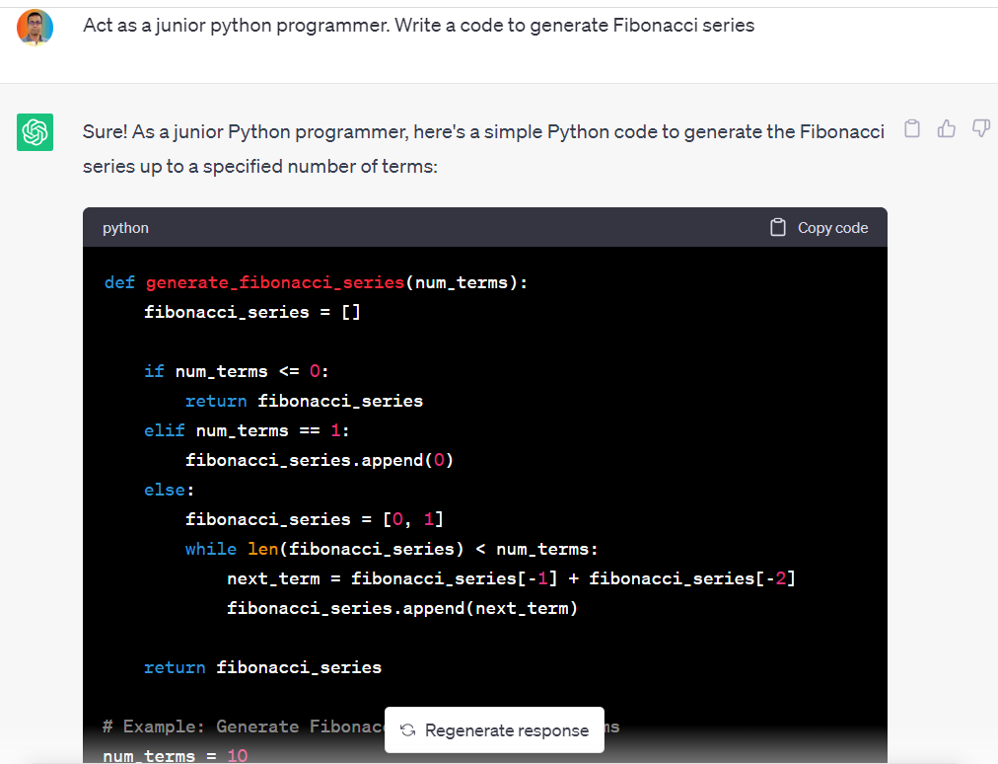

Slide 25
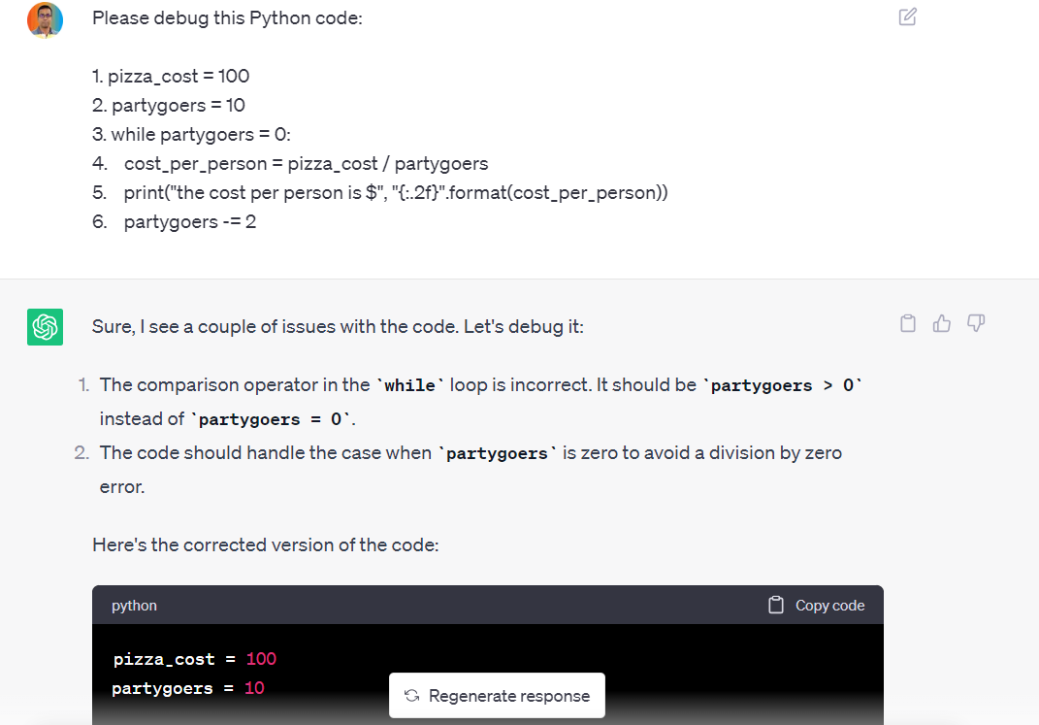

Slide 26
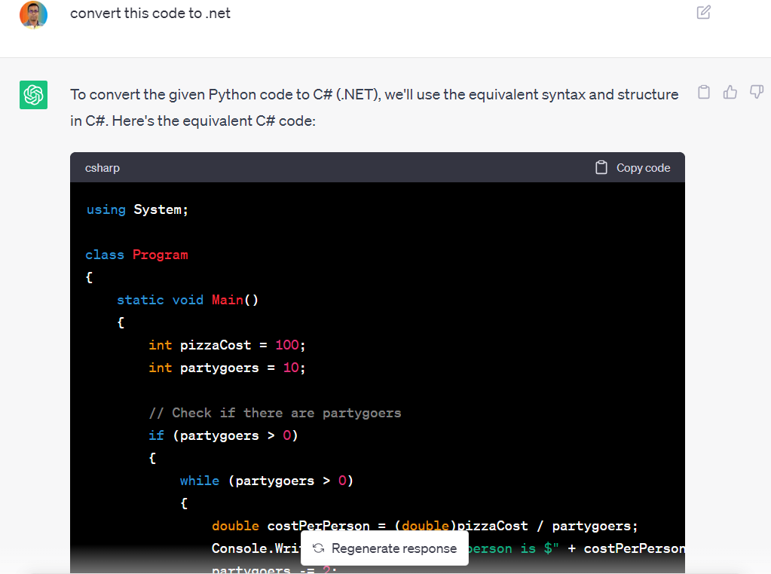

Slide 27
Prompt Engineering – Tactic 8
Fixing typos and semantic errors
Highlight typos and grammar mistakes in the text delimited by triple quotes “”” “Ask Eddy”the Generative Artificial Intelligence (GenAI) that helps your customers get answers to their questions based on your knowledge base content. Eddy provides an accurate answer quickly to your customer’s questions utilizing trustworthy content of your knowledge base. Eddy’s User Interface (UI) has been designed for simplicity; Its interface breads familiarity with ChatGPT-like tools, thus your customers can be easily accustomed to its UI. Instead of using a “keyword” search, you can type a question into the “Ask Eddy” UI, and Eddy will respond “””

Slide 28
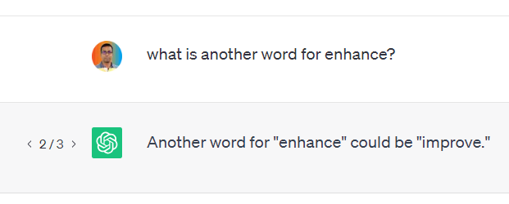
Prompt Engineering – Tactic 9
Regenerate button

Slide 29
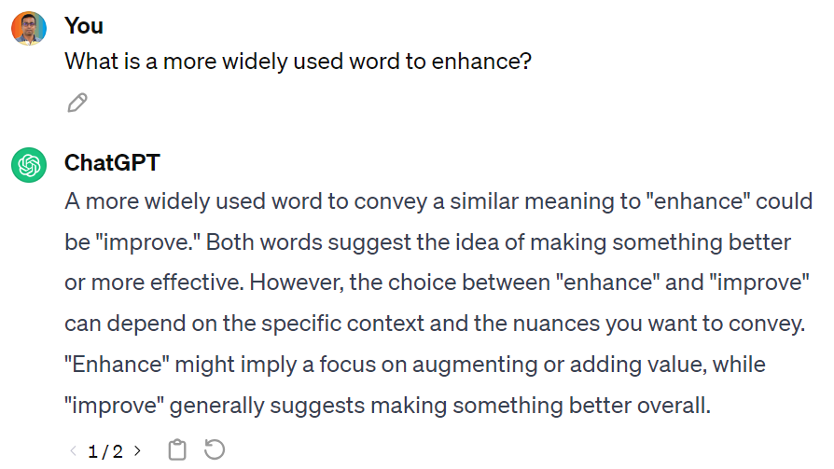
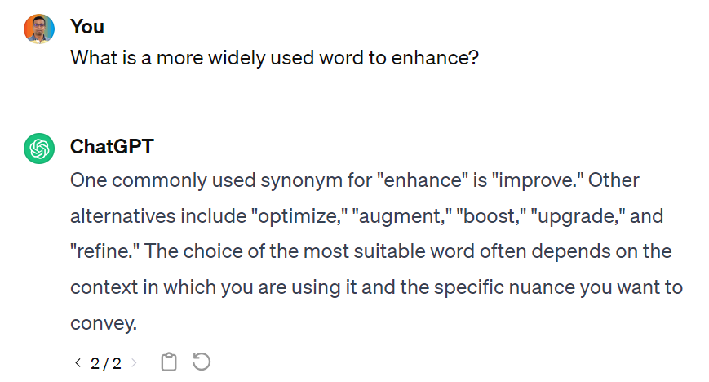
Prompt Engineering – Tactic 9
Regenerate button

Slide 30
Session 3
Notes:
Session 1

Slide 31
Business use case #1
Learning Management System
I am creating a learning management system for my organization. Please create five multiple-choice questions, each with correct answers, focusing on AI features. Ensure that the difficulty level of these questions is set to “hard”.
I am creating a learning management system for my organization. Please create two yes or no type questions , each with correct answers, focusing on article review reminder feature.

Slide 32
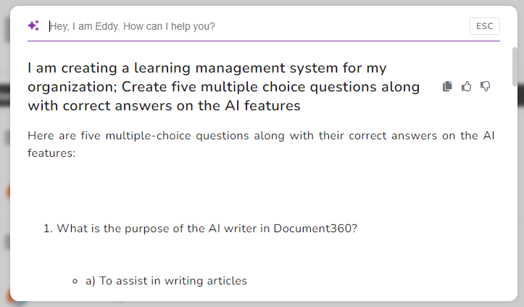

Slide 33
Business use case #2
Generate customer support email responses
write an email to a customer giving you a list of steps to insert business glossary

Slide 34
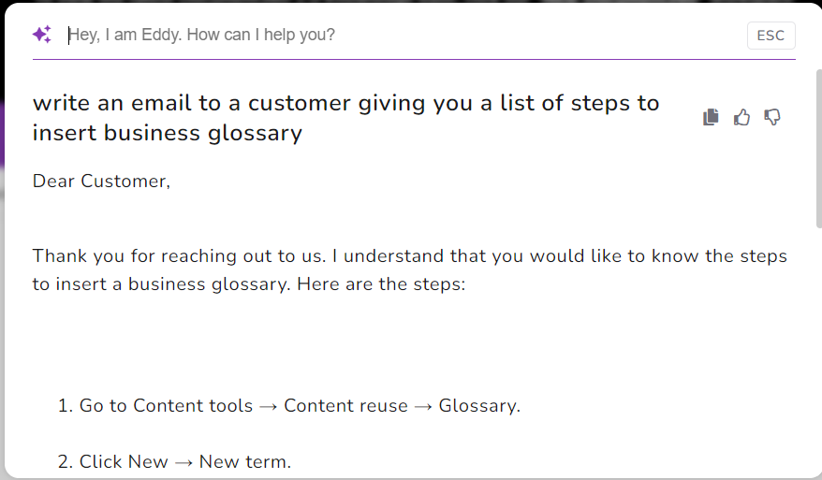

Slide 36
Business use case #3
Compare and show differences
compare freshdesk and zendesk integrations with Document360 in table format
Compare markdown and html editor in table format

Slide 37
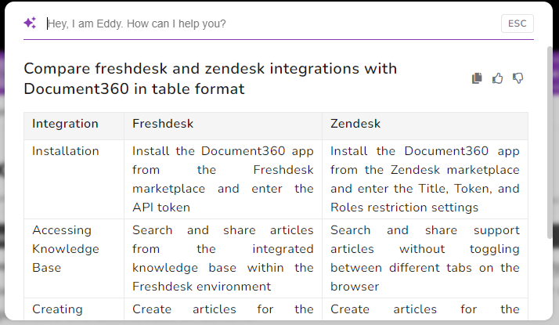

Slide 38
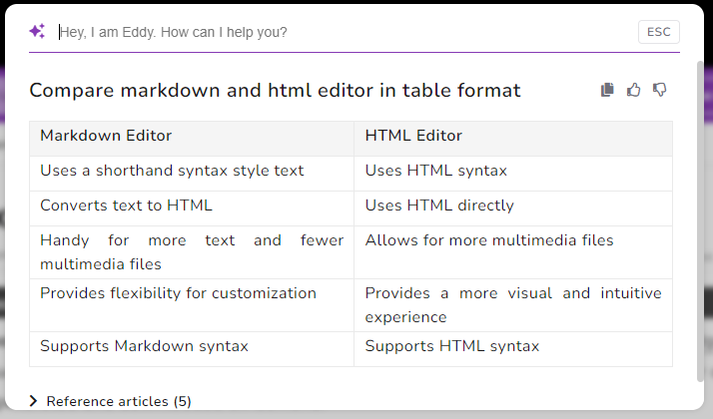

Slide 39
Business use case #4
Language translation on the fly
quelle est la taille du favicon ?
Wie viele Teamkonten sind im Businessplan verfügbar?

Slide 41
Business use case #5
Summarize long articles in few sentences
summarize home page builder
summarize all Document360 integrations with collaboration tools

Slide 42
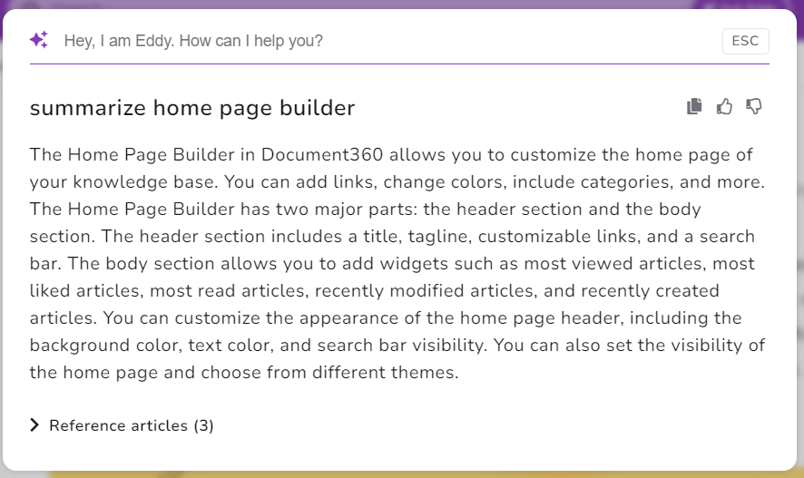

Slide 43
Business use case #6
Outputs in different formats
list all the pricing plans in bullet points with one line summary for each plan
list all AI features in table format
list all analytics features as JSON format as key value pair

Slide 44
Business use case #7
Key points from Teams/Zoom/Slack
Provide a good summary of discussion based on the following transcript that is enclosed in triple quotes
What is the purpose of building <feature name>
What are the limitations of <feature name>

Slide 45
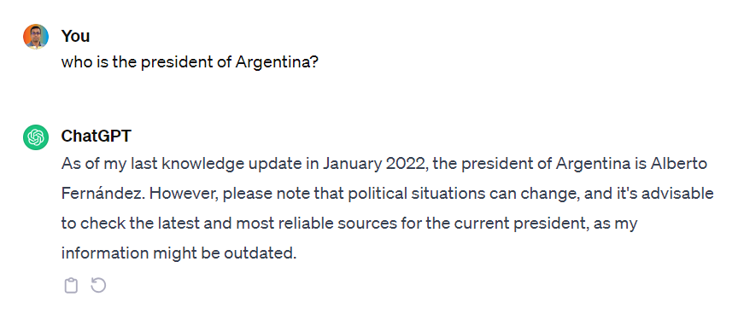
Known problems with ChatGPT 4
Information availability until April 2023

Slide 46
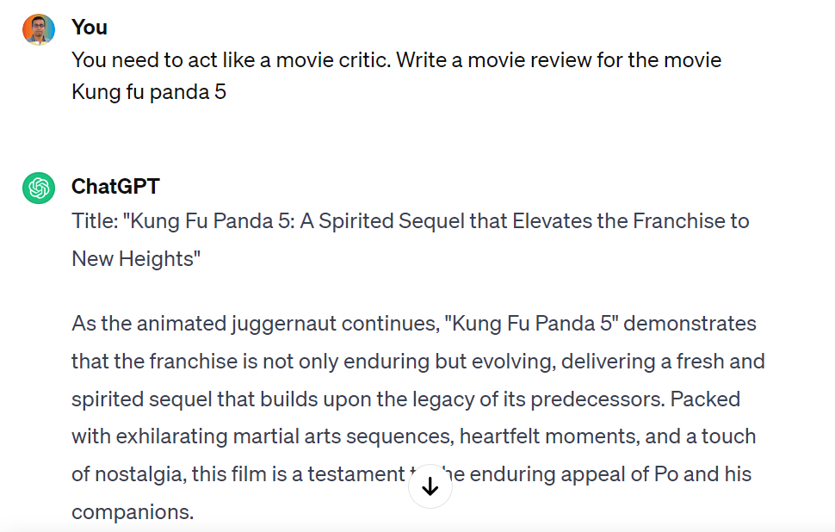
Known problems with ChatGPT 4
Hallucination

Slide 47
Other providers
https://www.perplexity.ai/
https://claude.ai/

Slide 48
Thank You!

