Slide 1
Webinar On
Crafting Seamless In-App Experiences
The crucial role of technical writers in in-app assistance
Speaker
Akash Jujam
Senior Information Developer
Precisely

Slide 2
Overview
The changing landscape of user assistance
User’s learning journey
What is in-app assistance
The role of in-app assistance
Aspects of in-app assistance
Best practices
Benefits
Key takeaways

Slide 3
The changing landscape of user assistance
Creating content for User Guides and Manuals (Technical Writer)
Creating multimedia content (Information Developer)
Creating content for in-application assistance (User Assistance Developers)

Slide 4
User’s learning journey
Reach
Acquisition
Activation
Retention/
Engagement
Loyalty
Notes:
https://zedaio.medium.com/the-5-stages-of-user-journey-in-product-management-caaa3bb31789

Slide 5
User’s learning journey
Reach:
Product awareness or discovery
Notes:
https://zedaio.medium.com/the-5-stages-of-user-journey-in-product-management-caaa3bb31789

Slide 6
User’s learning journey
Reach
Acquisition:
Try or buy
Notes:
https://zedaio.medium.com/the-5-stages-of-user-journey-in-product-management-caaa3bb31789

Slide 7
User’s learning journey
Reach
Acquisition
Activation:
Invest in product
Notes:
https://zedaio.medium.com/the-5-stages-of-user-journey-in-product-management-caaa3bb31789

Slide 8
User’s learning journey
Reach
Acquisition
Activation
Retention/
Engagement
Notes:
https://zedaio.medium.com/the-5-stages-of-user-journey-in-product-management-caaa3bb31789

Slide 9
User’s learning journey
Reach
Acquisition
Activation
Retention/
Engagement
Loyalty
Notes:
https://zedaio.medium.com/the-5-stages-of-user-journey-in-product-management-caaa3bb31789

Slide 10
What is in-application assistance
Assist user inside the application
Empower users to accomplish their tasks efficiently
Reduce frustration associated with learning curves
Enhance adoption and engagement with the software application
Example:
Corporate ICICI login
Notes:
Assist user inside the application (frictionless learning experience)
Empower users to accomplish their tasks efficiently (self-service)
Reduce frustration associated with learning curves or errors
Enhance user satisfaction and engagement with the software application. (product adoption)
attendees could benefit from seeing a few real-use examples. Apps like Swiggy, Zomato, Ola, provide chat support to assist uses in-app. Chat support is one of the aspects of in-app assistance - other apps like ICICI corporate bank has self-help available in/on-app(see the right margin) - https://cibnext.icicibank.com/corp/AuthenticationController?FORMSGROUP_ID__=AuthenticationFG&__START_TRAN_FLAG__=Y&FG_BUTTONS__=LOAD&ACTION.LOAD=Y&AuthenticationFG.LOGIN_FLAG=1&BANK_ID=ICI&ITM=nli_corp_primer_login_btn_desk&_ga=2.105267779.1300325940.1709063148-1682123359.1709063148.

Slide 11
The role of in-app assistance
Reduce friction
Increase user engagement
Empower of users
Faster onboarding
Support for diverse user base

Slide 12
Types of in-app assistance
Embedded Documentation
Product tours
Contextual help buttons and icons
Chatbots
Tooltips and hover texts
Error messages and troubleshooting
In-context guides
Get started guides

Slide 13
Aspects of In-Application Assistance

Slide 14
Understanding user needs
User research and analysis
User-centric approach
Impact of well crated in-app assistance
Notes:
Introduction (1 minute):
Introduce the importance of understanding user needs in the context of in-app assistance.
Significance of Understanding User Needs (2 minutes):
Discuss the critical role of user research and analysis in identifying user needs and preferences.
Explain how understanding user behavior and pain points informs the development of effective in-app assistance.
User-Centric Approach to Content Creation (3 minutes):
Define the user-centric approach to content creation, emphasizing the importance of tailoring content to meet the specific needs and preferences of the target audience.
Discuss strategies for gathering user feedback and incorporating it into the development of in-app assistance materials.
Impact of Well-Crafted In-App Assistance (2 minutes):
Highlight the direct correlation between well-crafted in-app assistance and user satisfaction.
Share examples or case studies illustrating how addressing user needs through effective assistance leads to improved user engagement and retention.

Slide 15
Understanding user needs | Example: Slack

Slide 16
Crafting effective onboarding content
What is onboarding content
Role of writers in onboarding content
Importance of getting started guides
Notes:
Introduction (1 minute):
Introduce onboarding content and its importance in guiding new users through the initial steps of using an application.
Role of Writers in Onboarding Content (2 minutes):
Discuss the responsibilities of writers in creating welcoming messages, tutorials, and getting started guides for new users.
Emphasize the writer's role in ensuring onboarding content is clear, concise, and accessible to users of all skill levels.
Importance of Getting Started Guides (2 minutes):
Explain why getting started guides are essential for helping new users navigate an application's features and functionalities.
Discuss best practices for designing and structuring getting started guides to optimize user comprehension and engagement.
Showcase of Successful Onboarding Content (2 minutes):
Showcase examples of successful onboarding content from popular applications.
Analyze what makes these examples effective in guiding users through the onboarding process and fostering a positive initial experience.

Slide 17
Effective onboarding content | Example: Salesforce

Slide 18
Contextual help and guidance
What is contextual help
Its importance
Writer’s role
Strategies for delivery
Example:
Microsoft Word
Notes:
Introduction (1 minute):
Introduce the concept of contextual help and its role in providing timely assistance within the application interface.
Explanation of Concept (2 minutes):
Define contextual help as real-time guidance provided to users at the point of need within the application interface.
Differentiate contextual help from traditional documentation by highlighting its immediacy and relevance.
Writer's Role (3 minutes):
Explain the critical role of technical writers in creating contextual help content, such as tooltips, hover texts, and in-context guides.
Discuss the writer's responsibility in crafting clear, concise, and user-friendly assistance materials that align with user needs.
Strategies for Delivery (3 minutes):
Discuss various strategies for delivering contextual help effectively, including the use of tooltips, hover texts, and interactive overlays.
Emphasize the importance of seamless integration with the application interface to provide a frictionless user experience.
Conclusion (1 minute):
Summarize the key points discussed in the section, emphasizing the significance of contextual help in improving user experience.
Encourage further exploration of contextual help strategies and the writer's role in crafting them.

Slide 19
Error messages and troubleshooting
Importance of clear error messages
Craft user-friendly error messages
Comprehensive troubleshooting guides
Impact of Effective Error Resolution
Notes:
Introduction (1 minute):
Introduce the importance of clear error messaging and effective troubleshooting in maintaining a positive user experience.
Writer's Role in Crafting Error Messages (2 minutes):
Discuss the writer's responsibility in crafting clear, user-friendly error messages that help users understand and resolve issues.
Emphasize the importance of using plain language and providing actionable steps for error resolution.
Creating Comprehensive Troubleshooting Guides (2 minutes):
Explore the writer's role in creating comprehensive troubleshooting guides that help users troubleshoot and resolve common issues.
Discuss best practices for organizing troubleshooting information and providing step-by-step instructions.
Impact of Effective Error Resolution (1 minute):
Highlight the impact of effective error resolution on user experience, including increased user satisfaction and retention.
Share examples of how well-crafted error messages and troubleshooting guides have improved the overall user experience in real-world scenarios.

Slide 20
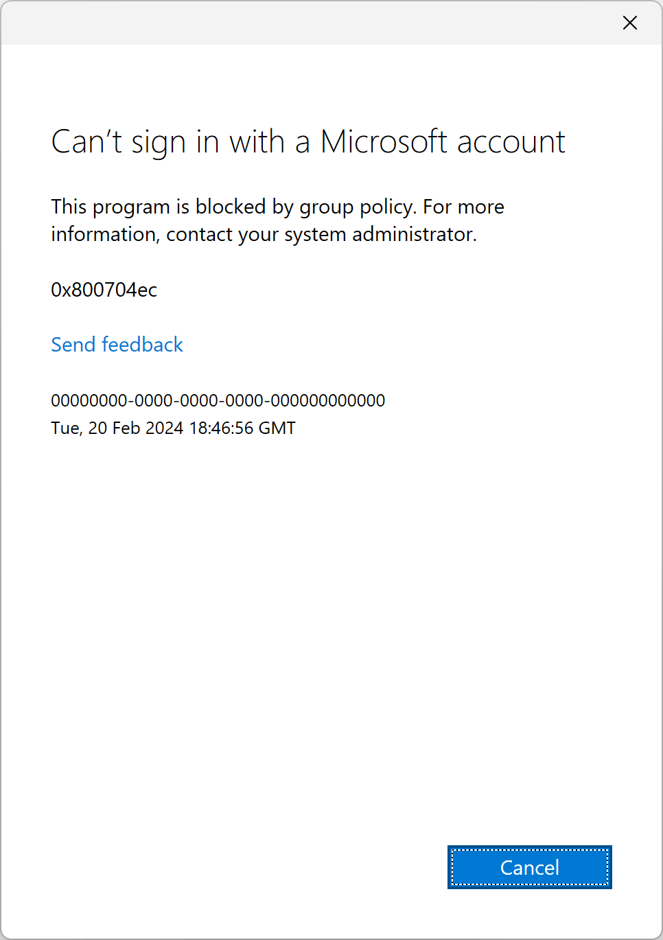
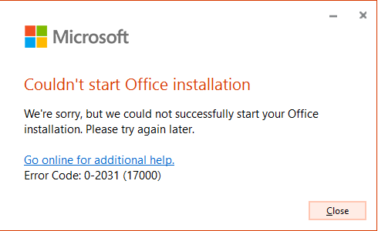
Error messages | Example: MS Office Suite

Slide 21
In-app documentation and knowledgebase
Self-service knowledgebase
Searchable knowledgebase
Integrated help content
Self-service support
Notes:
Introduction (1 minute):
Introduce the importance of in-app documentation and a searchable knowledge base in providing users with self-service support options.
Integration of Embedded Documentation (2 minutes):
Highlight the integration of embedded documentation within the application interface, allowing users to access relevant information without leaving the application.
Discuss the benefits of embedded documentation, such as improved user accessibility and reduced support overhead.
Importance of a Searchable Knowledge Base (2 minutes):
Discuss the importance of a searchable knowledge base accessible from within the app, enabling users to quickly find answers to their questions.
Explore strategies for organizing and structuring a knowledge base to facilitate easy navigation and retrieval of information.
Showcase of Successful In-App Documentation Implementations (2 minutes):
Showcase examples of successful in-app documentation implementations, highlighting their effectiveness in providing users with self-service support options.
Analyze what makes these examples successful and how they contribute to a positive user experience.

Slide 22
Integrated Self-help | Example: Slack

Slide 23
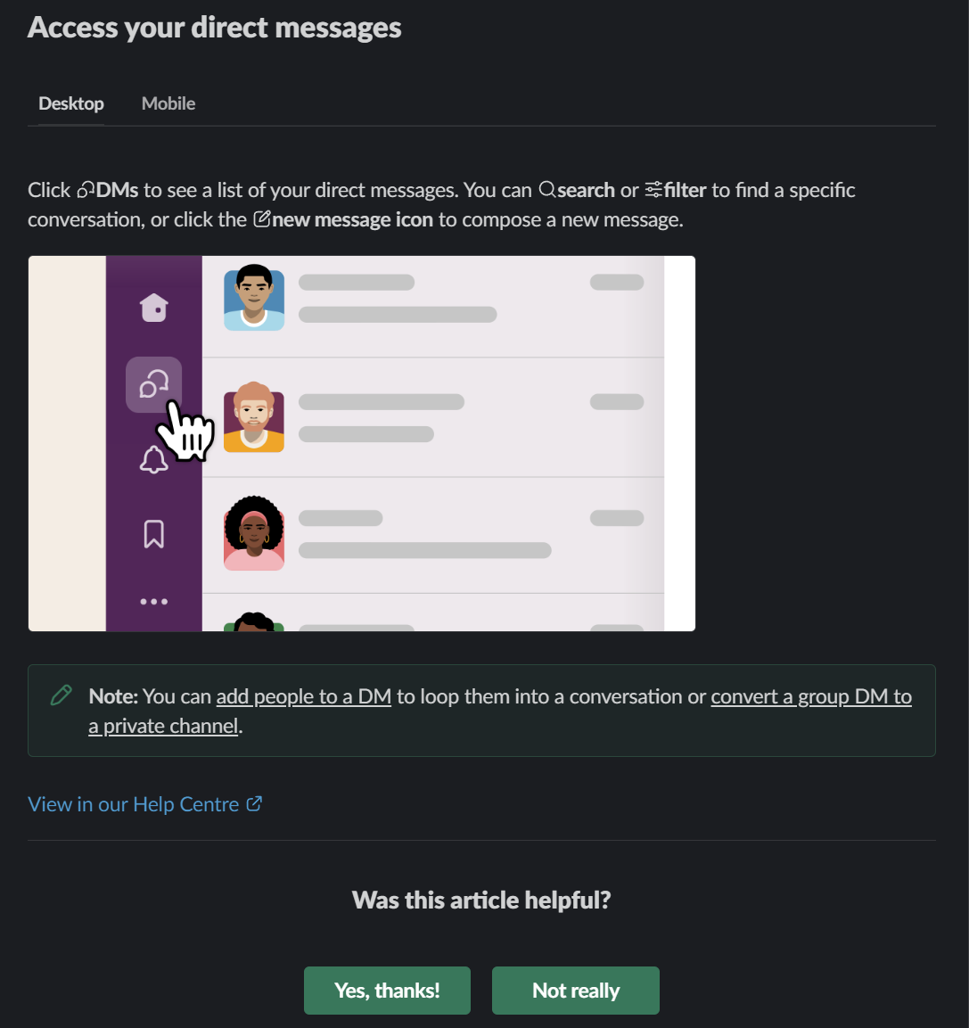
User feedback and continuous improvement
Collect feedback for continuous improvement
Incorporate user feedback
Notes:
Introduction (1 minute):
Introduce the importance of collecting user feedback and using it to drive continuous improvement in in-app assistance.
Collecting User Feedback (2 minutes):
Discuss strategies for collecting user feedback through forms, surveys, and other feedback mechanisms built into the application.
Emphasize the importance of actively soliciting and listening to user feedback to identify areas for improvement.
Using Feedback for Continuous Improvement (2 minutes):
Explore how writers can use user feedback to identify pain points, usability issues, and areas for improvement in in-app assistance materials.
Discuss strategies for incorporating user feedback into the iterative development process to drive continuous improvement.
Conclusion and Q&A (2 minutes):
Summarize the key points discussed in the section, emphasizing the significance of contextual help in enhancing user experience.
Encourage further exploration of contextual help strategies and the writer's role in crafting them.

Slide 24
Best practices
Add different content types
Group resources
Use segmentation
Use an in-app widget
Embed your chatbot
Embed video tutorials
Track engagement
Notes:
Add different content types to your resource center
Group resources under categories for a seamless customer experience
Use segmentation to personalize in-app support
Use an in-app widget to make your resource center easy to find
Embed your chatbot and ticketing software in your in-app support center
Embed video tutorials to keep users in-app
Track engagement with your resource center to improve

Slide 25
Benefits
Enhanced User Experience
Increased User Satisfaction
Greater User Engagement
Reduced Learning Curve
Faster Issue Resolution
Improved Productivity
Empowered User Base
Reduced Support Costs
Positive Brand Perception
Continuous Improvement

Slide 26
Key takeaways
User-Centric Approach
Strategic Content Creation
Contextual Assistance
Effective Error Resolution
Accessible Documentation
Feedback Utilization
Enhanced User Engagement
Empowerment through Assistance
Notes:
User-Centric Approach: significance of adopting a user-centric approach in designing in-application assistance, focusing on meeting the specific needs and preferences of users.
Strategic Content Creation: strategies for crafting welcoming messages, tutorials, and getting started guides that effectively guide users through the onboarding process and facilitate their initial interaction with the application.
Contextual Assistance: importance of providing contextual help and guidance within the application interface, such as tooltips and in-context guides, to deliver relevant information precisely at the point of need.
Effective Error Resolution: impact of clear error messages and troubleshooting guides on the user experience, and how timely resolution of issues contributes to increased user satisfaction and retention.
Accessible Documentation: Explore the integration of embedded documentation and searchable knowledge bases within the application, ensuring that users can easily access relevant information without leaving the interface.
Feedback Utilization: Learn the importance of collecting user feedback and leveraging it for continuous improvement in in-application assistance features, driving enhancements based on user insights and preferences.
Enhanced User Engagement: Recognize how addressing user needs through effective assistance fosters a positive initial experience, leading to improved user engagement and long-term retention.
Empowerment through Assistance: Understand how well-crafted in-application assistance empowers users to navigate the application confidently and independently, contributing to a more positive overall user experience.

Slide 27
Questions?

Slide 28
Thank You!

